Slide 1
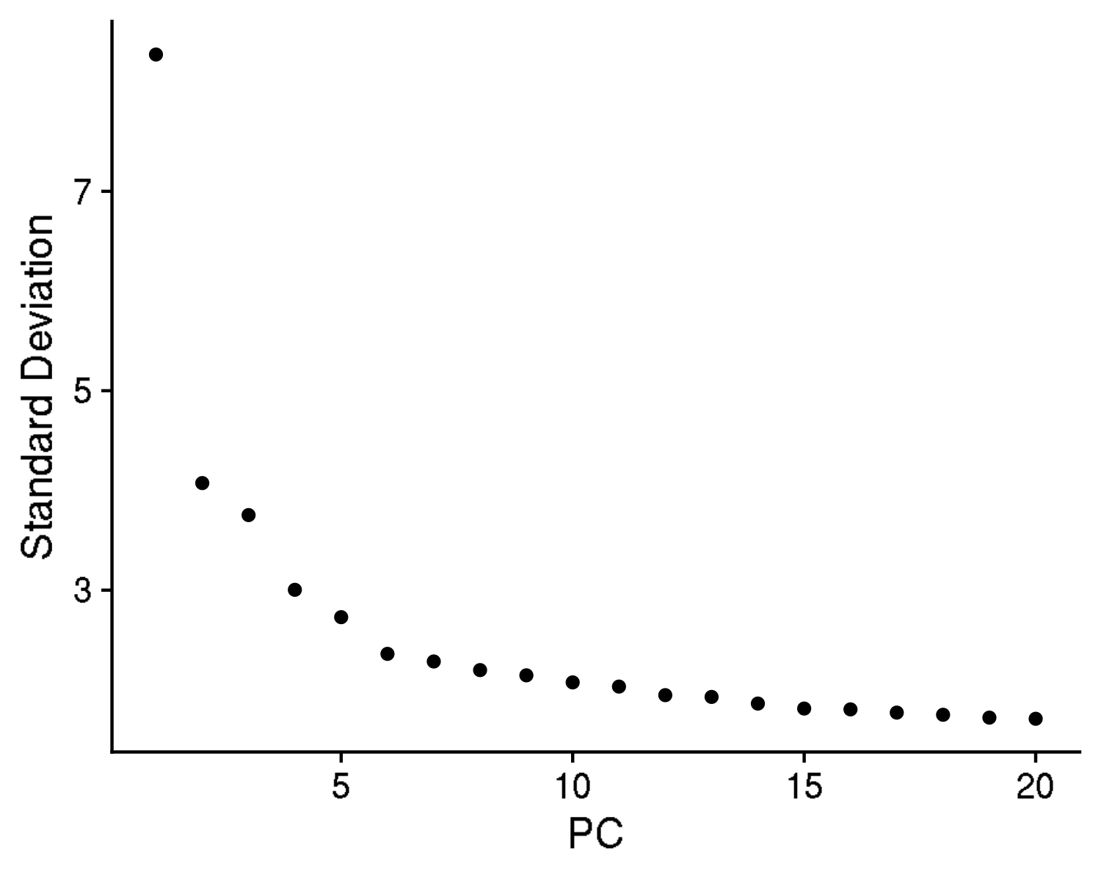
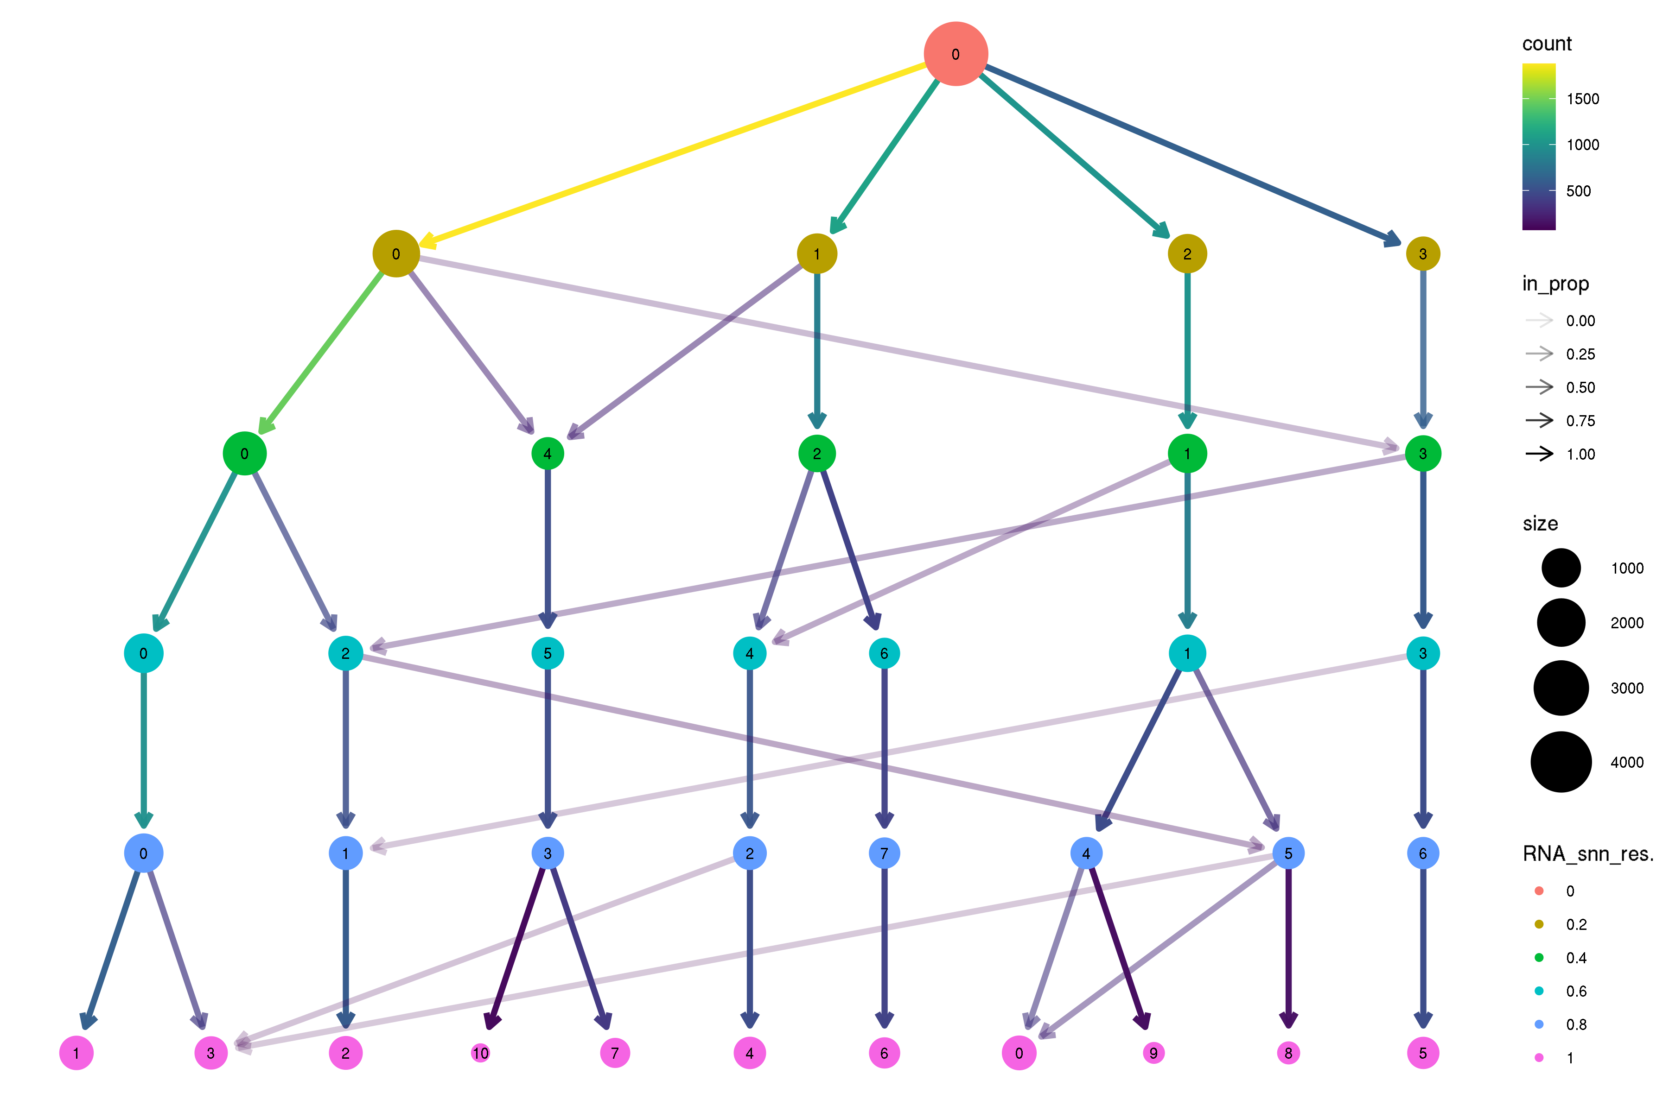
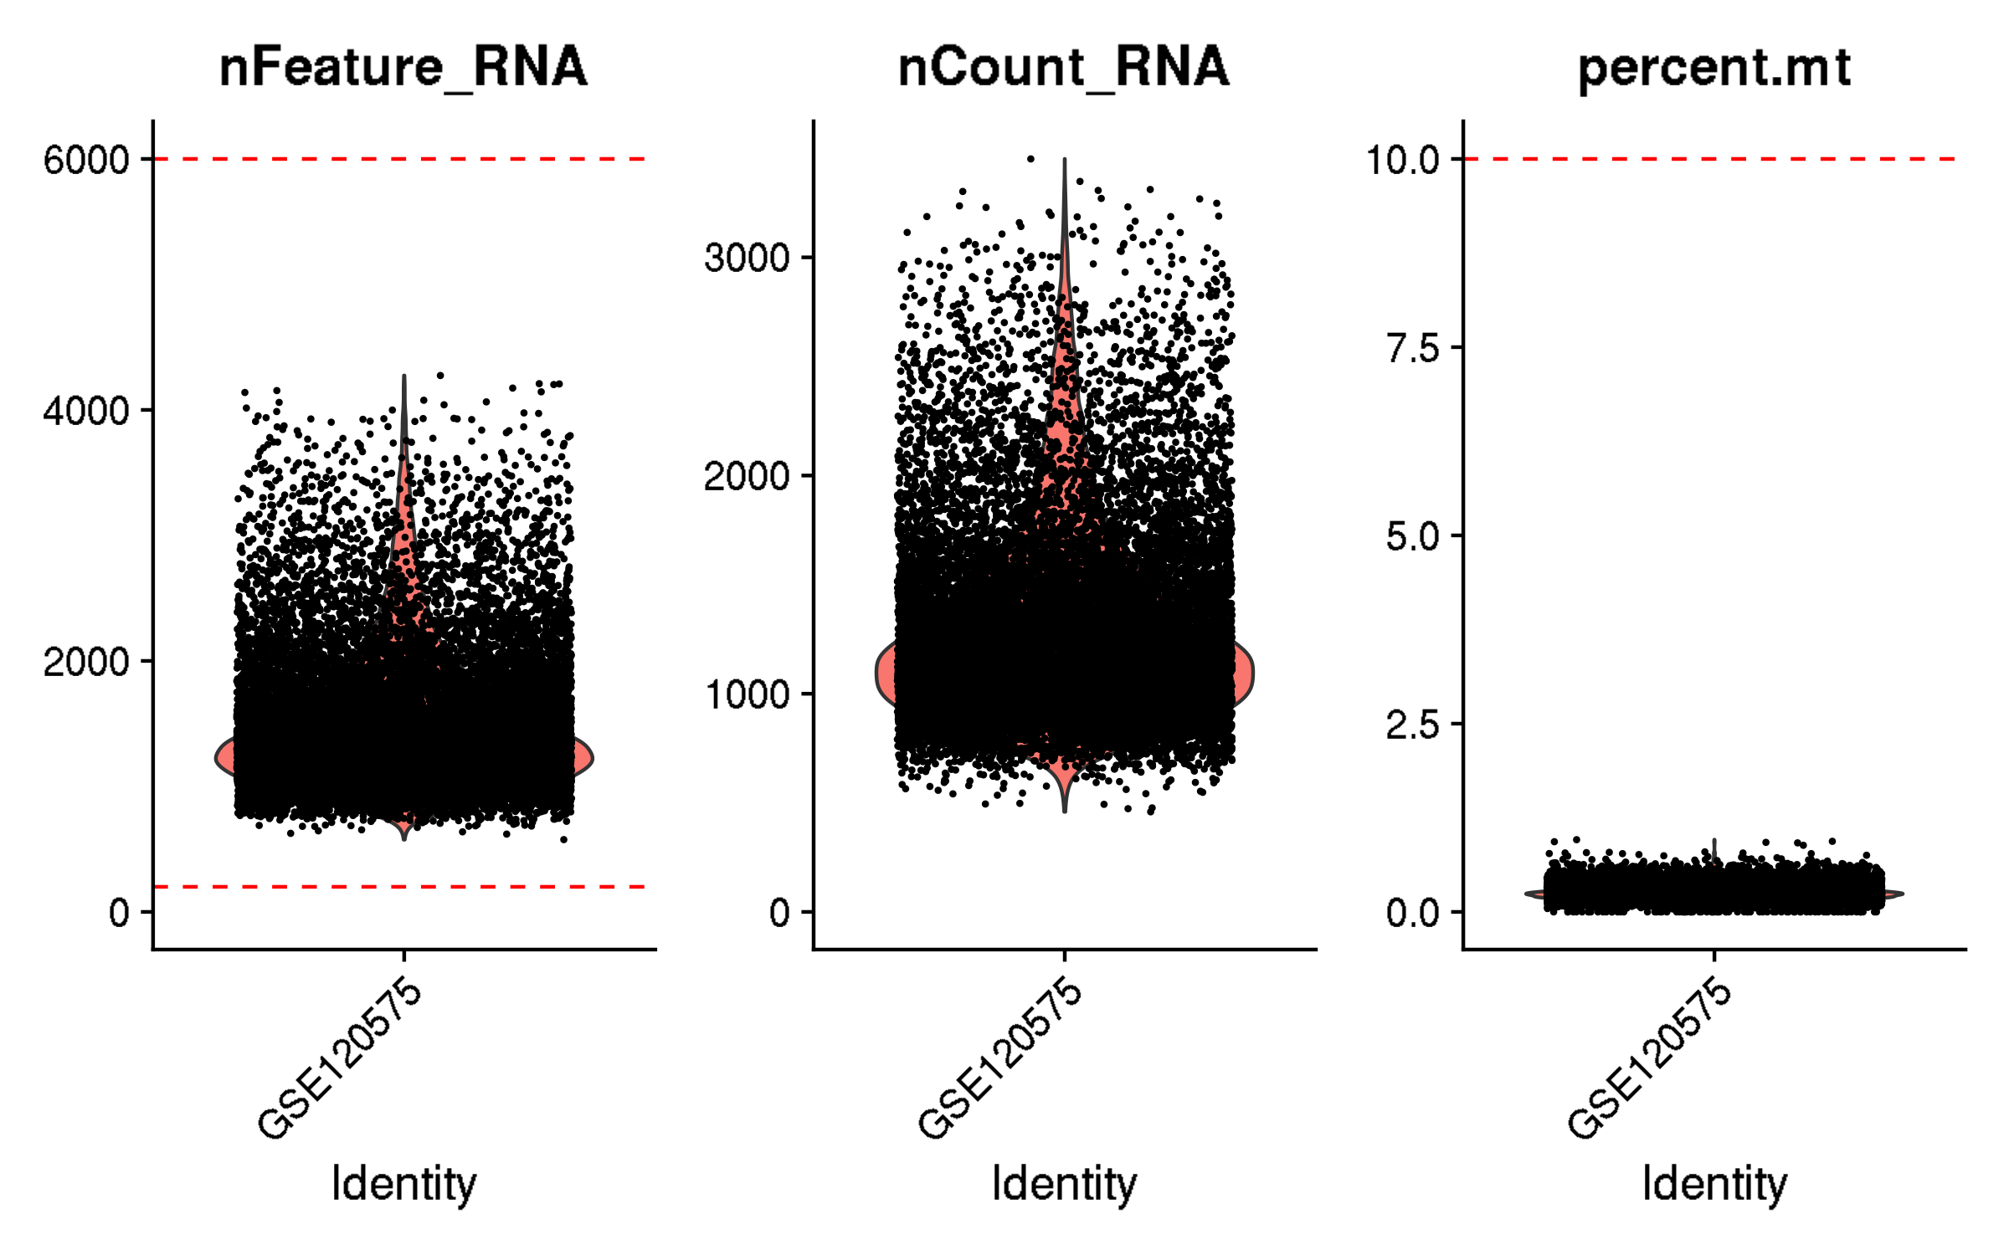
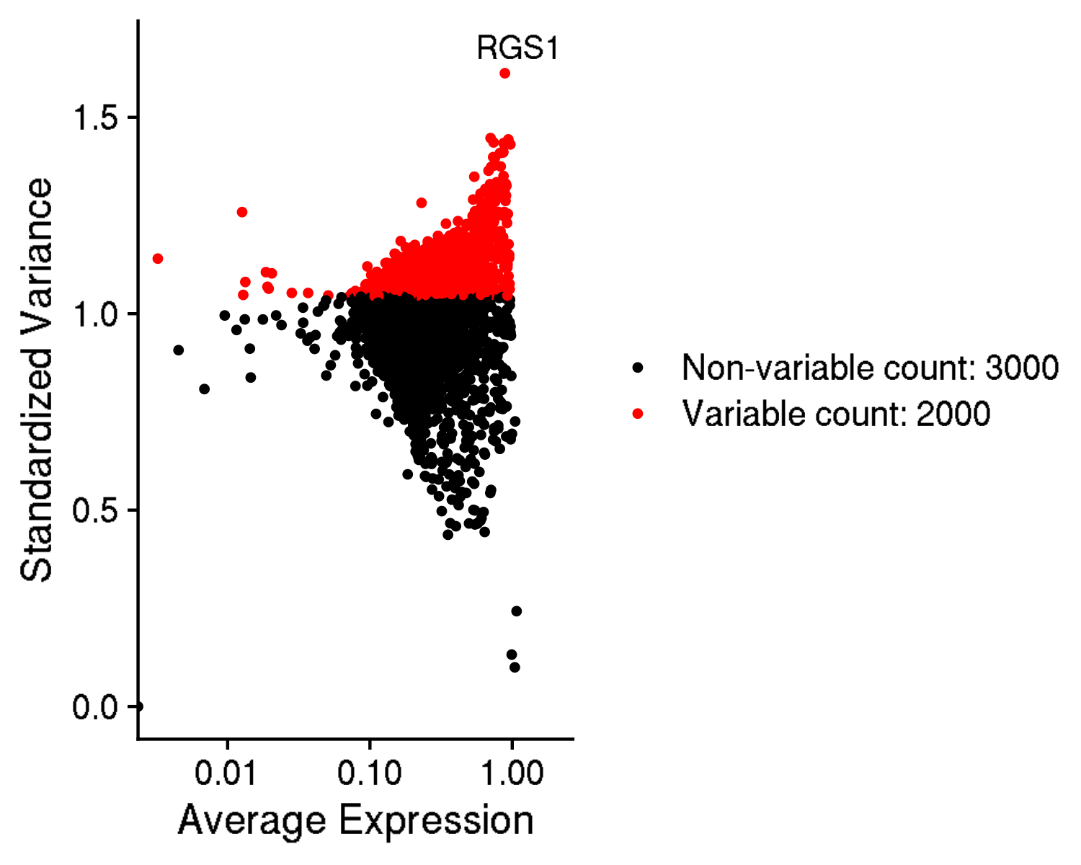
GSE120575: TILs from cancer patients receiving immune checkpoint blockade
Inspection and quality control

Slide 2
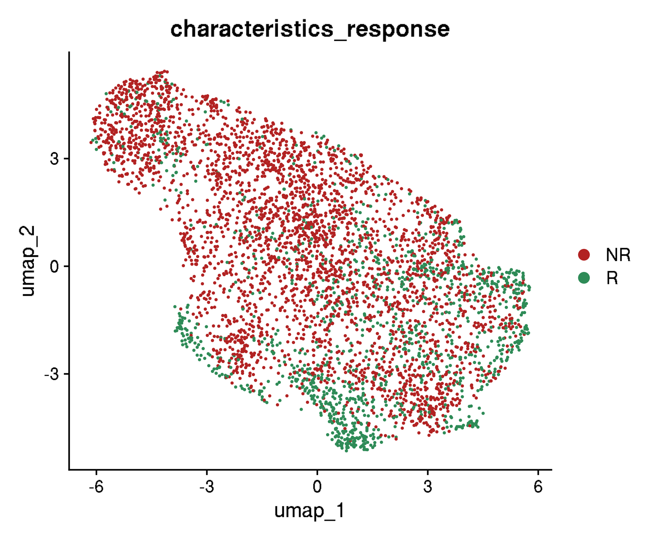
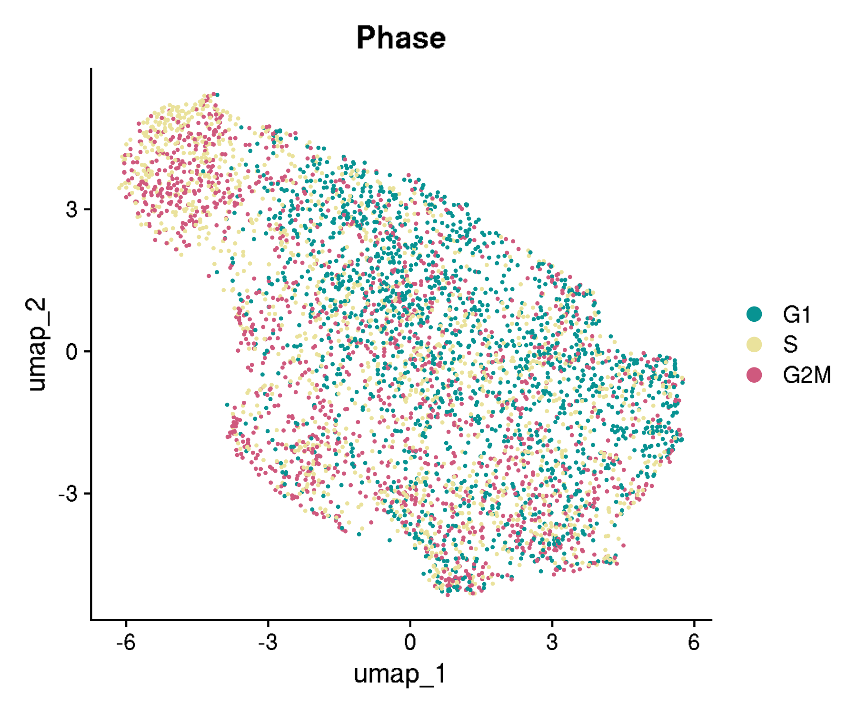
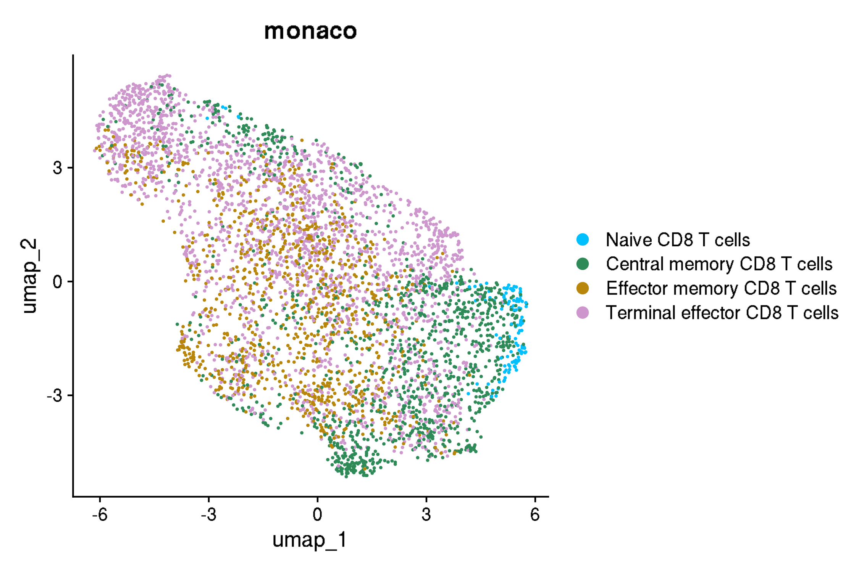
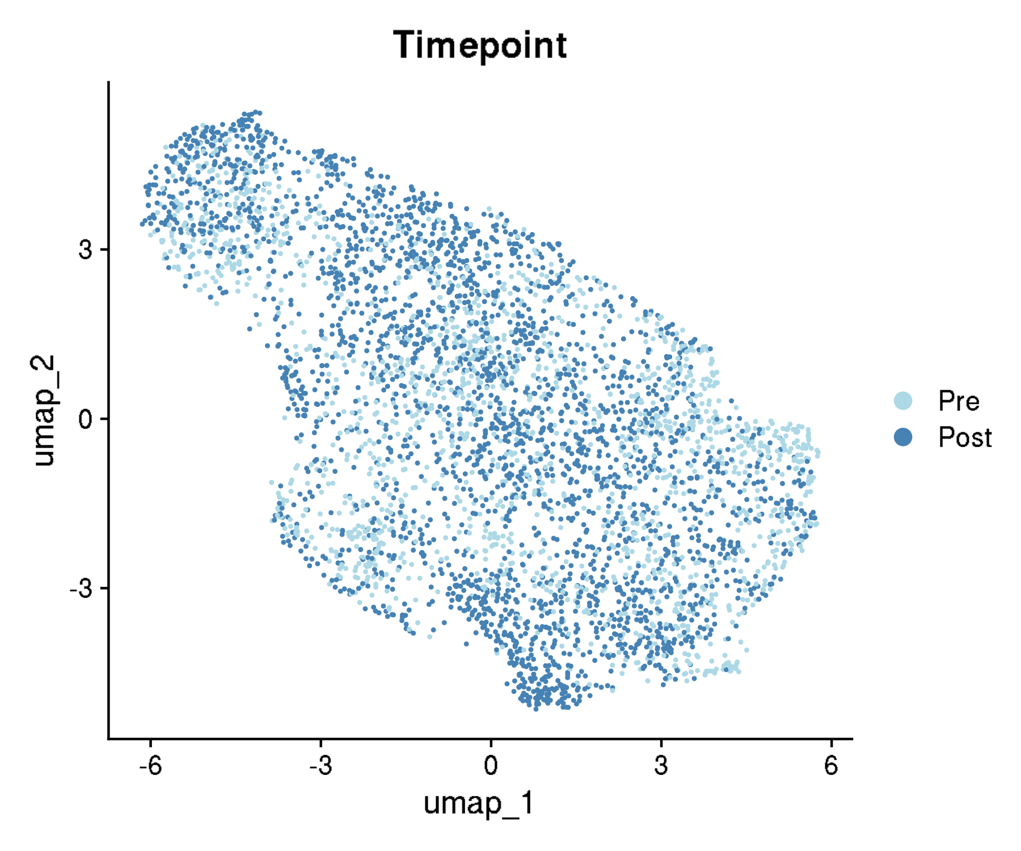
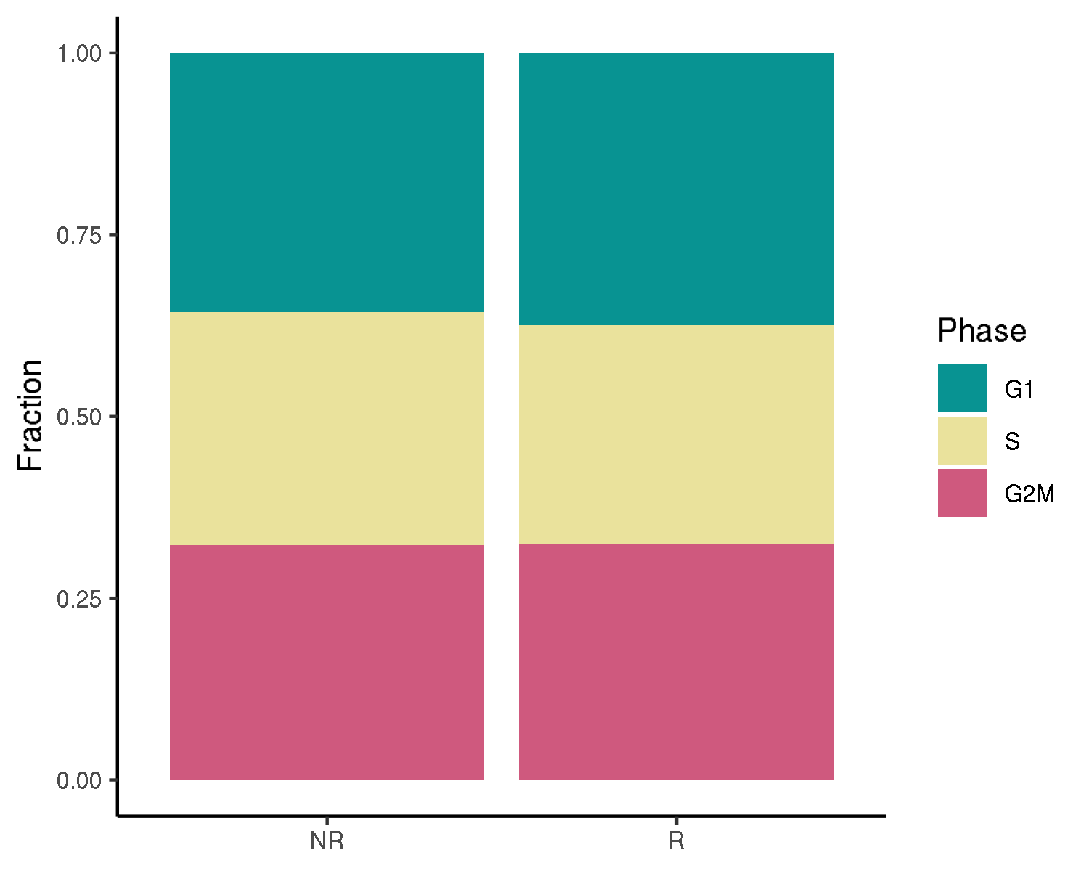
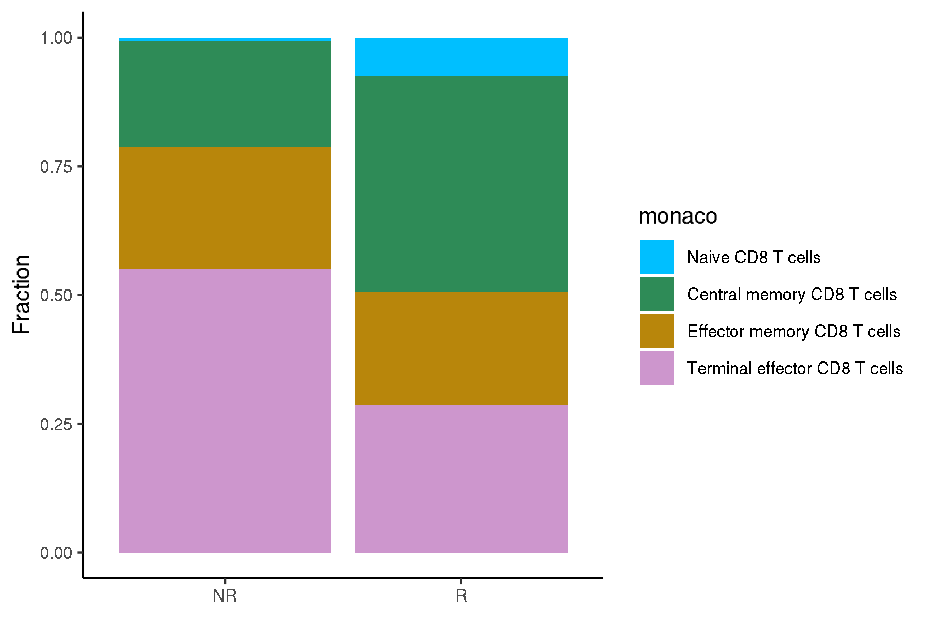
GSE120575: TILs from cancer patients receiving immune checkpoint blockade
UMAPs for cell annotations

Slide 3
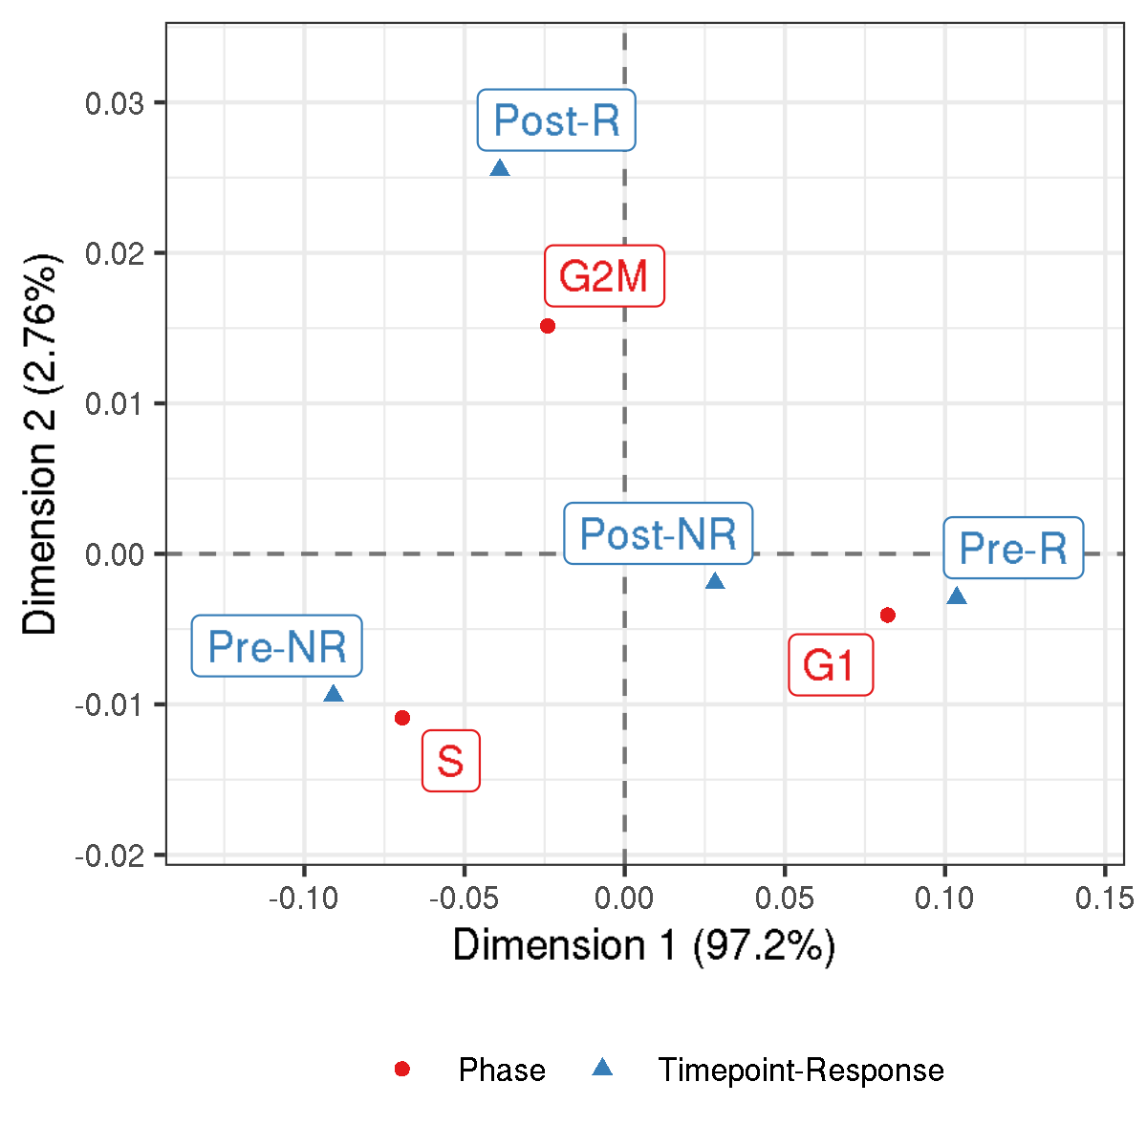
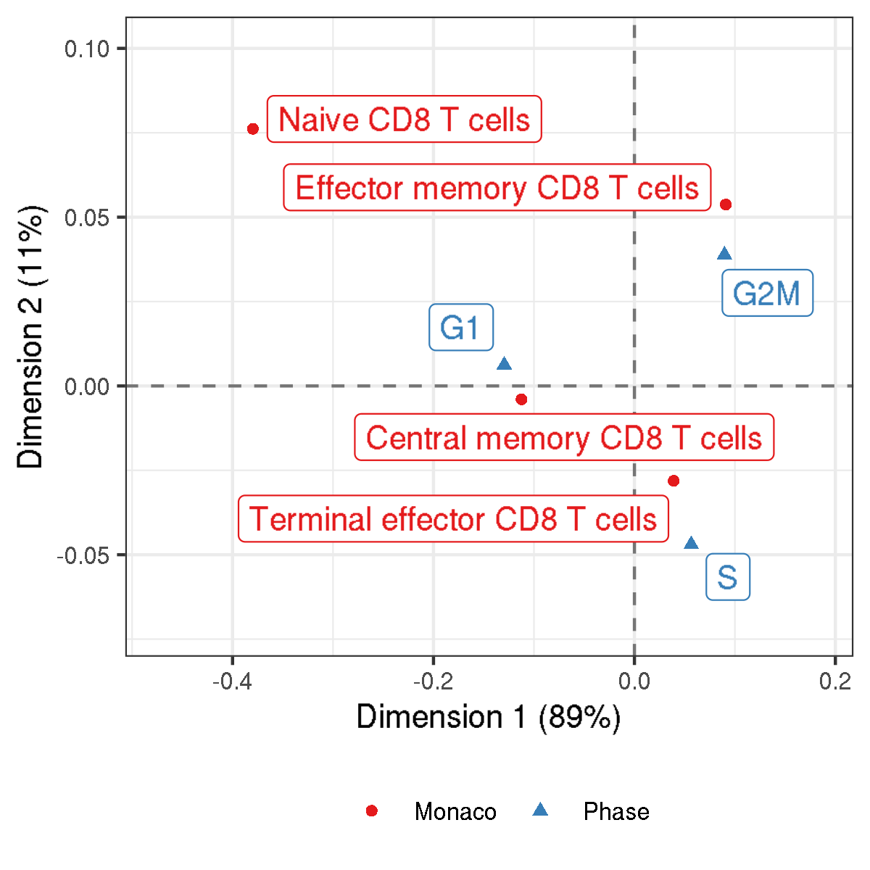
GSE120575: TILs from cancer patients receiving immune checkpoint blockade
Correspondence analysis of contingency tables of metadata

Slide 4
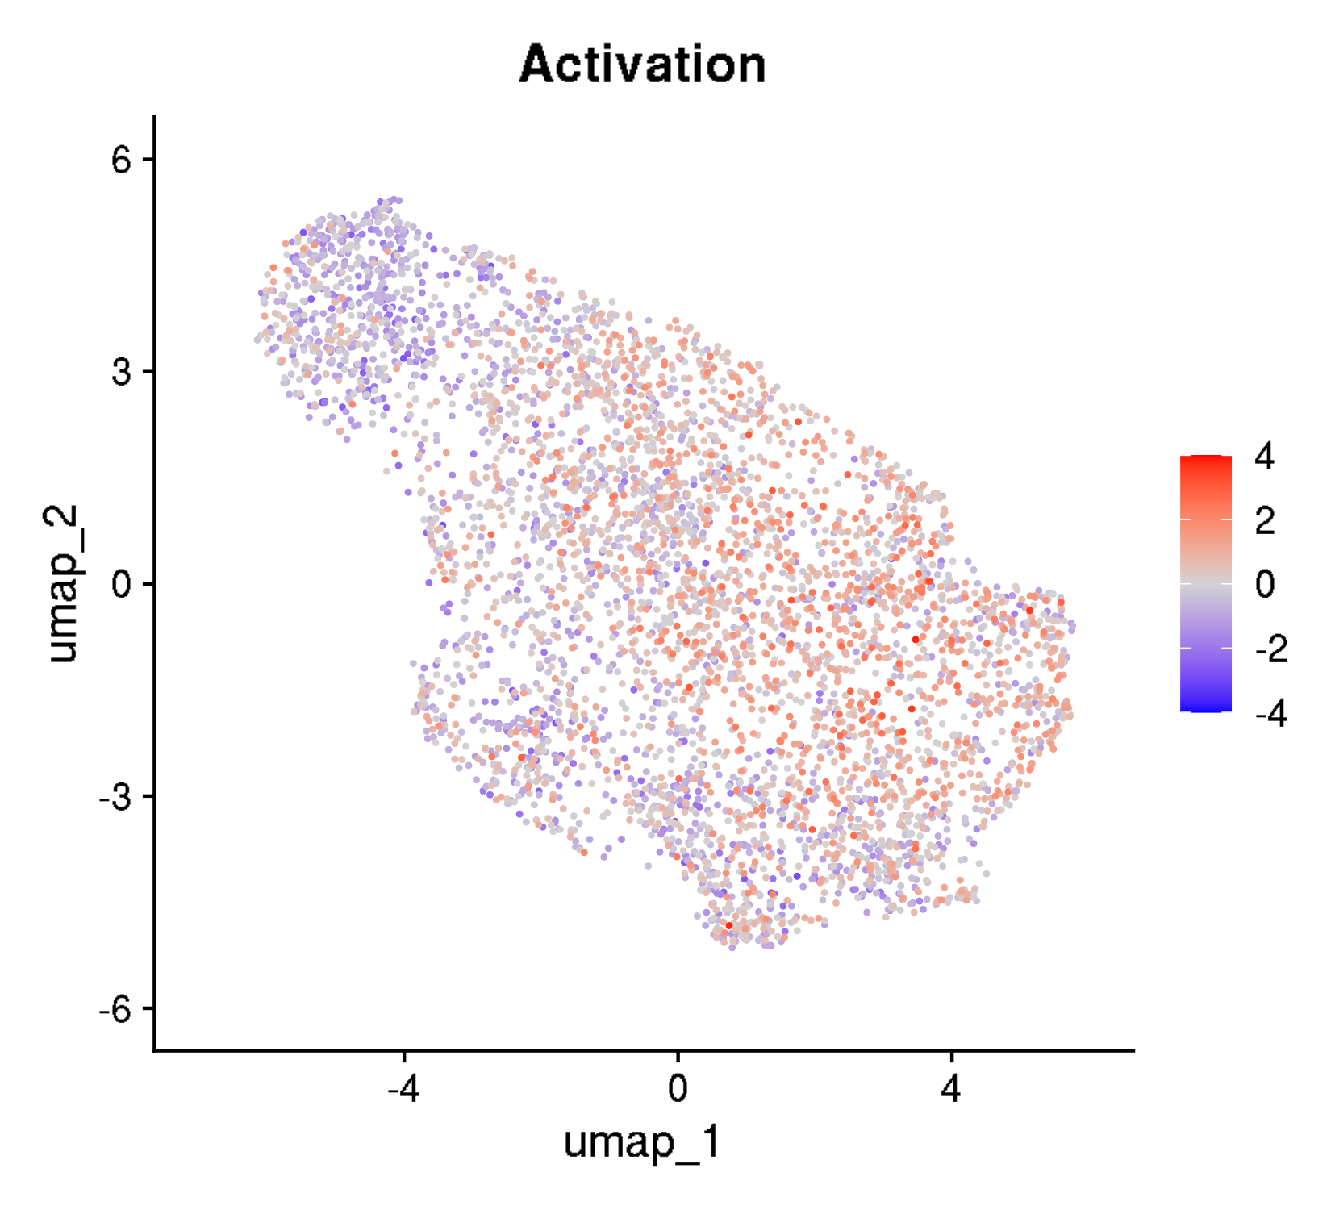
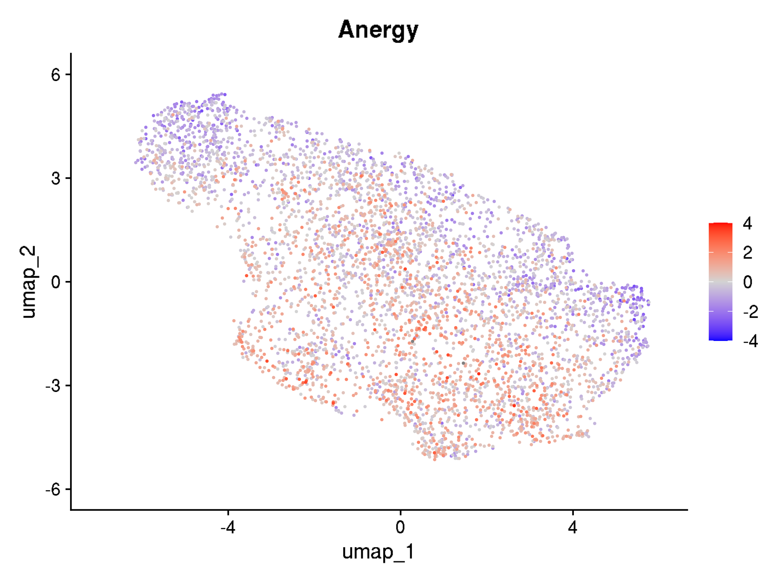
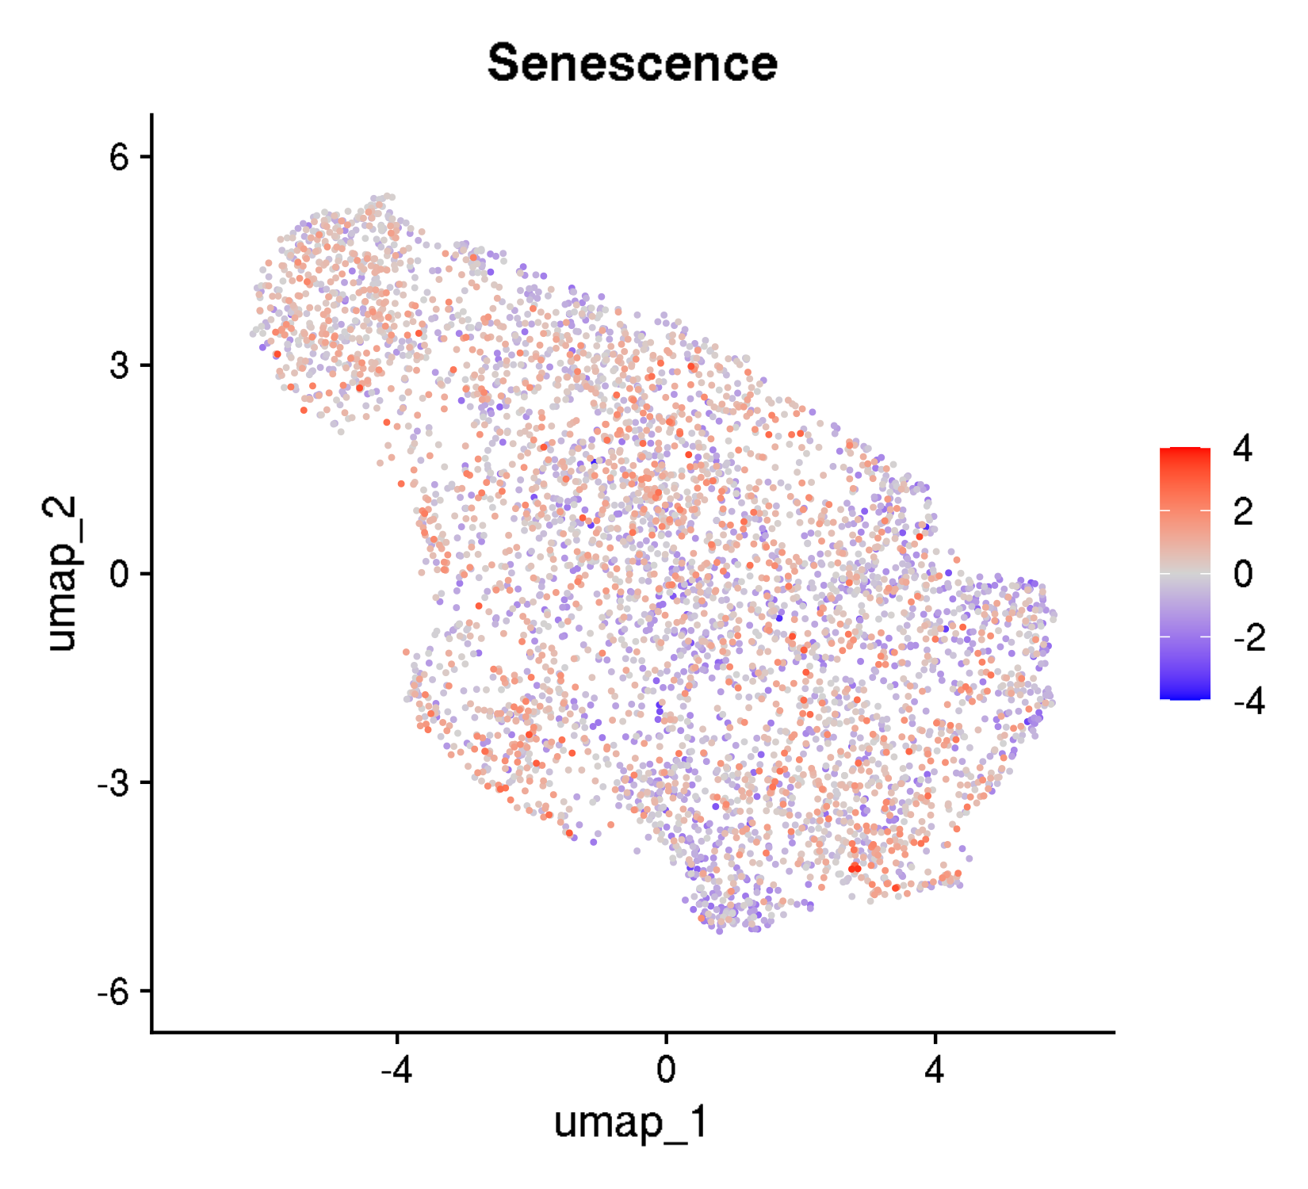
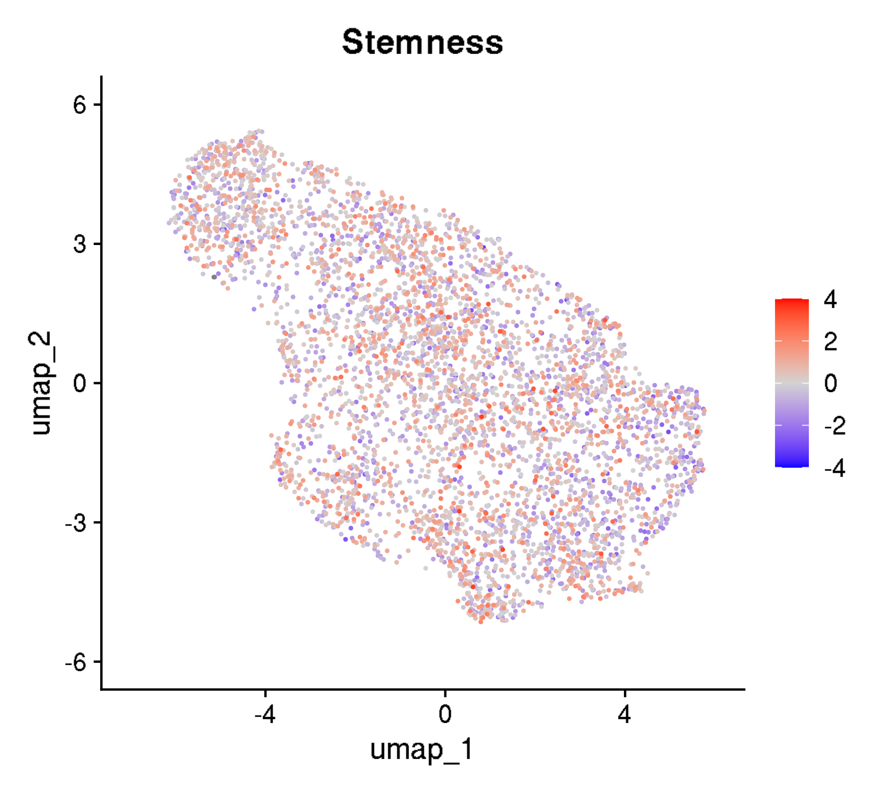
GSE120575: TILs from cancer patients receiving immune checkpoint blockade
UMAPs for cell states

Slide 5
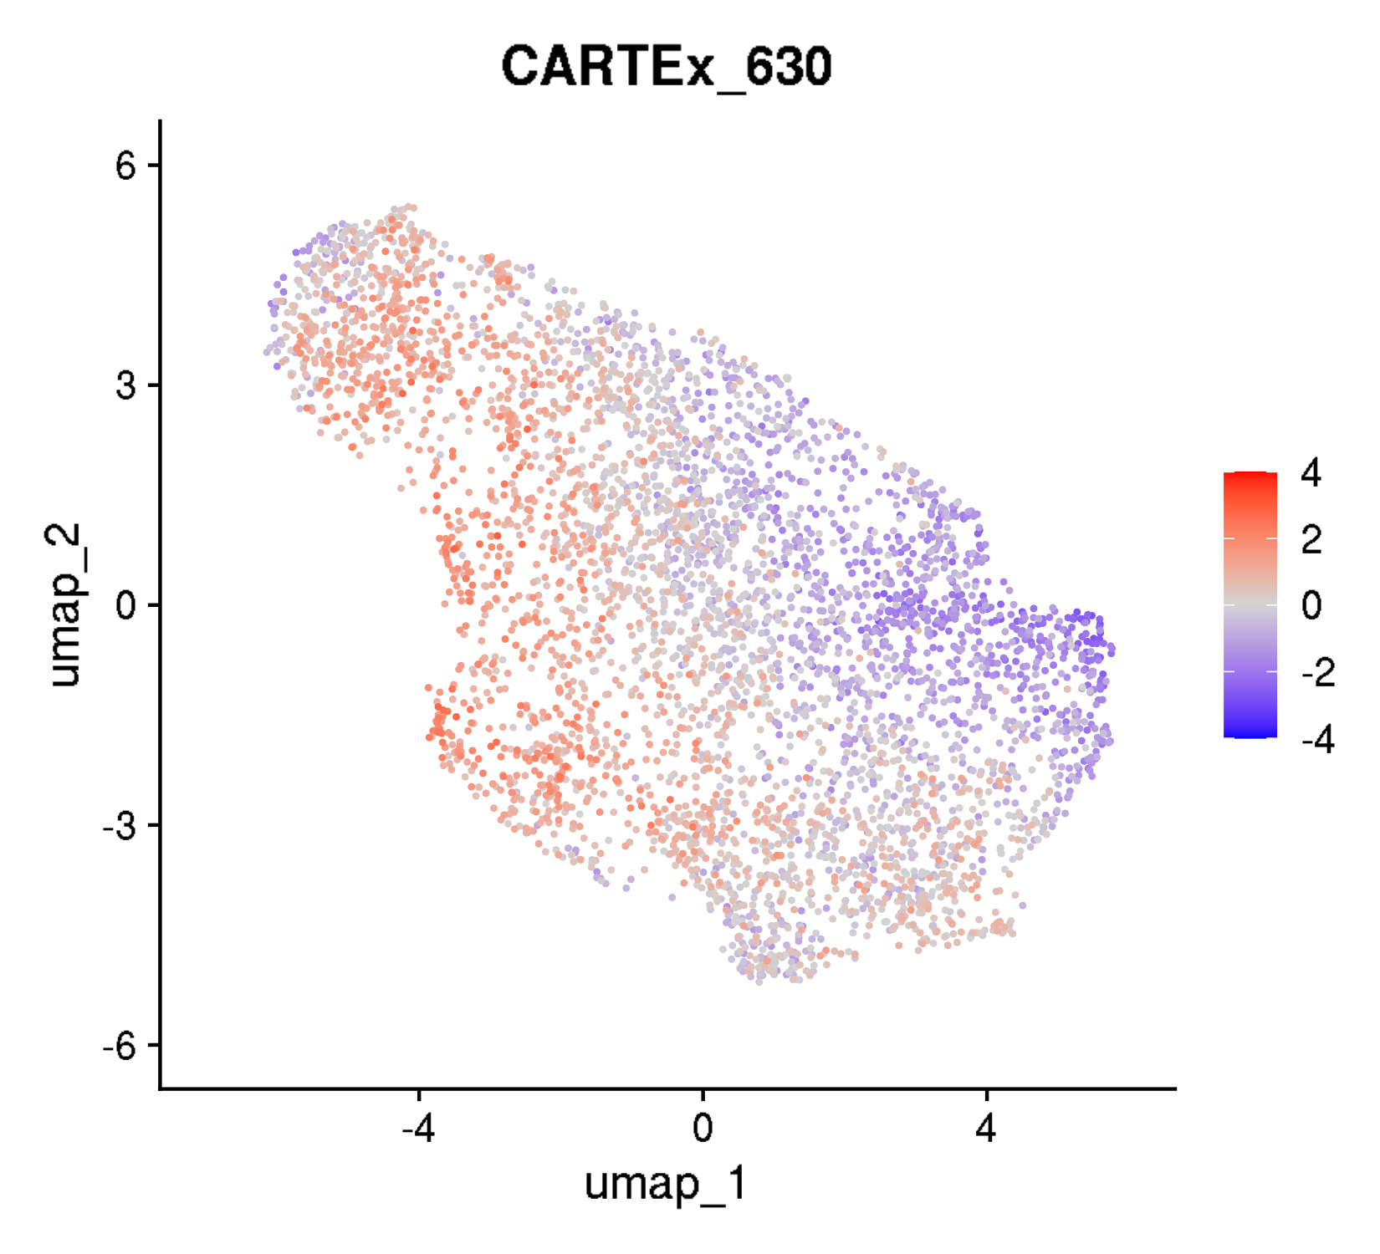
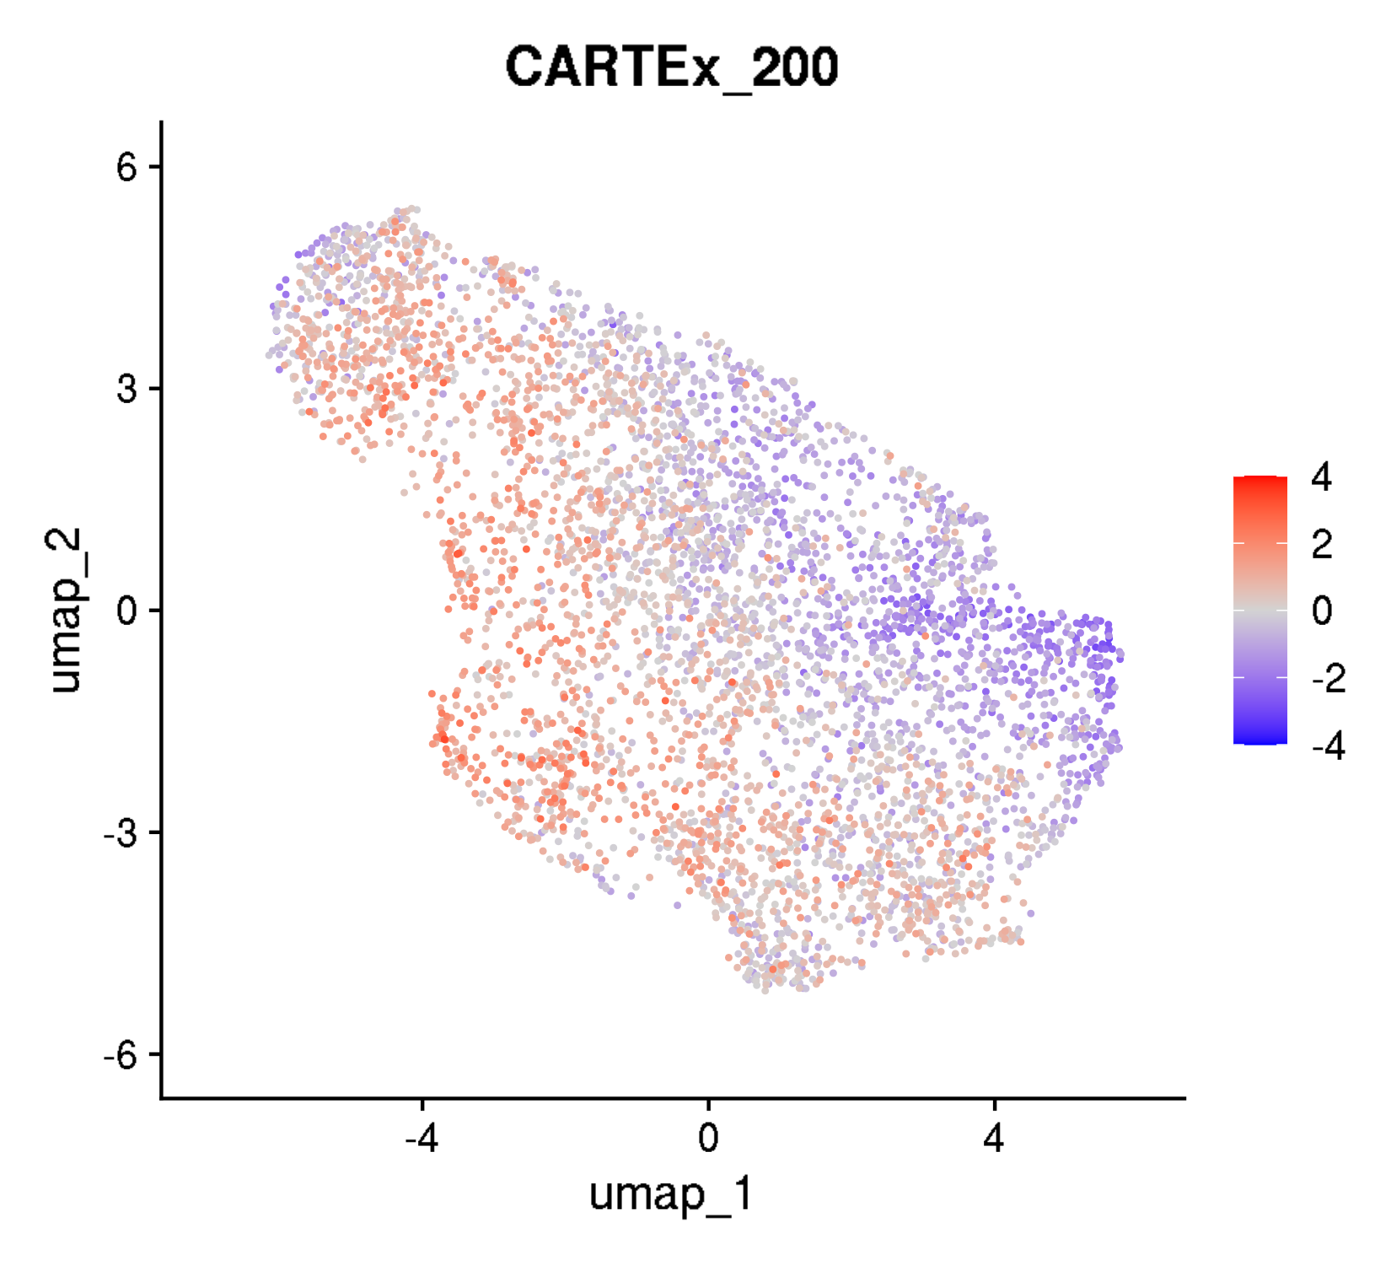
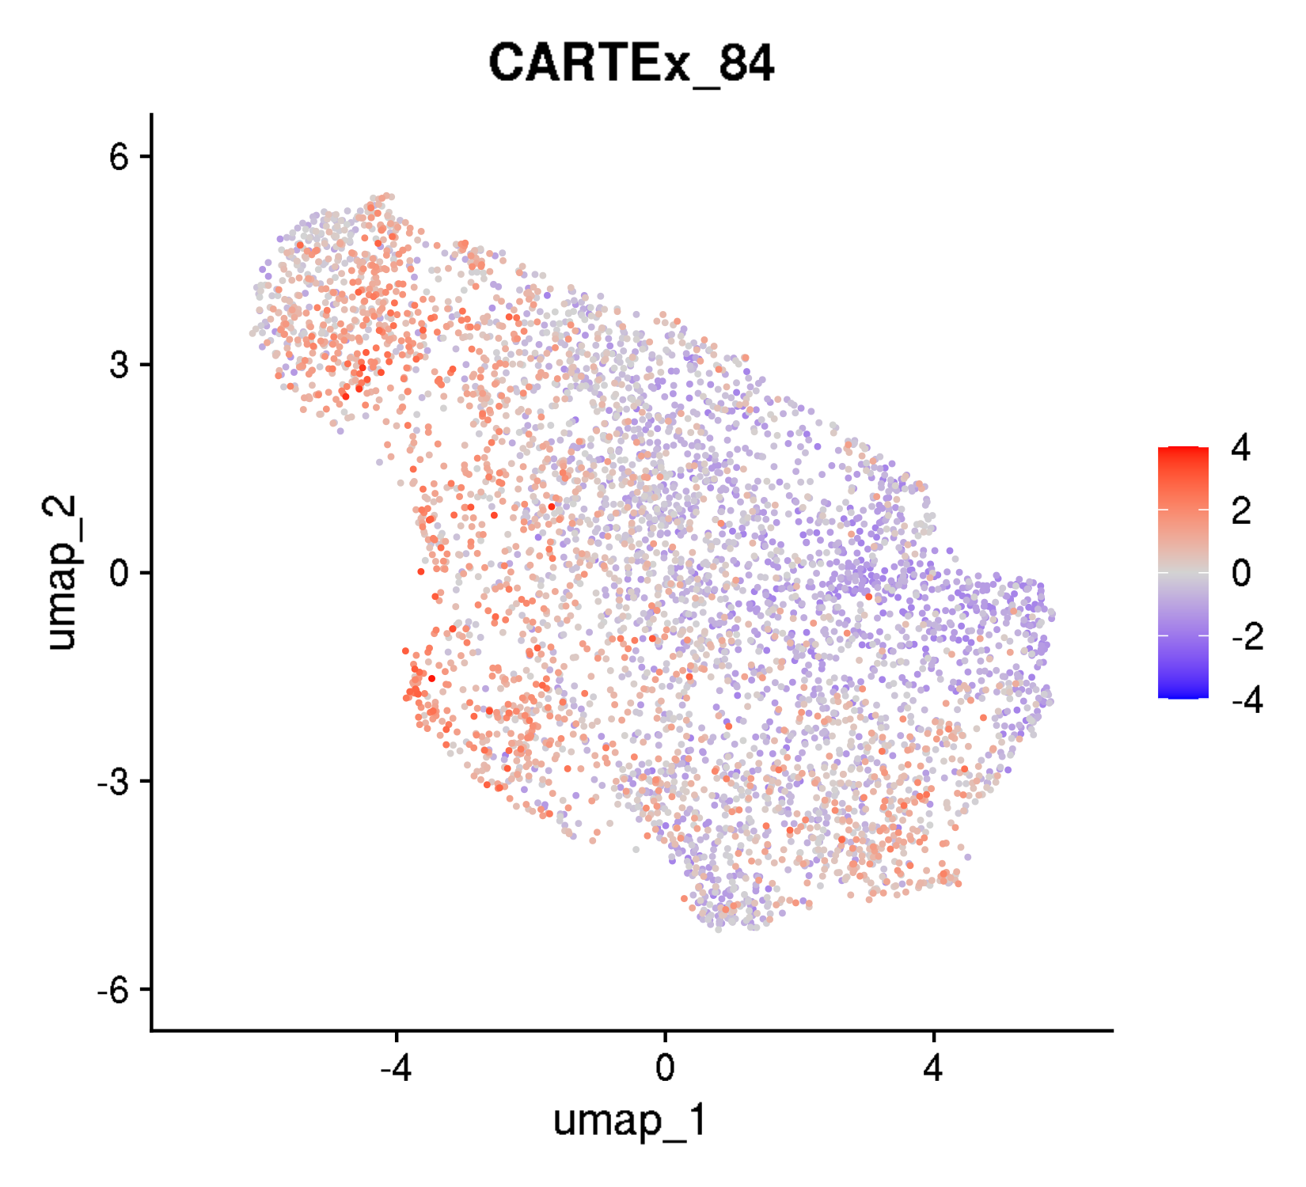

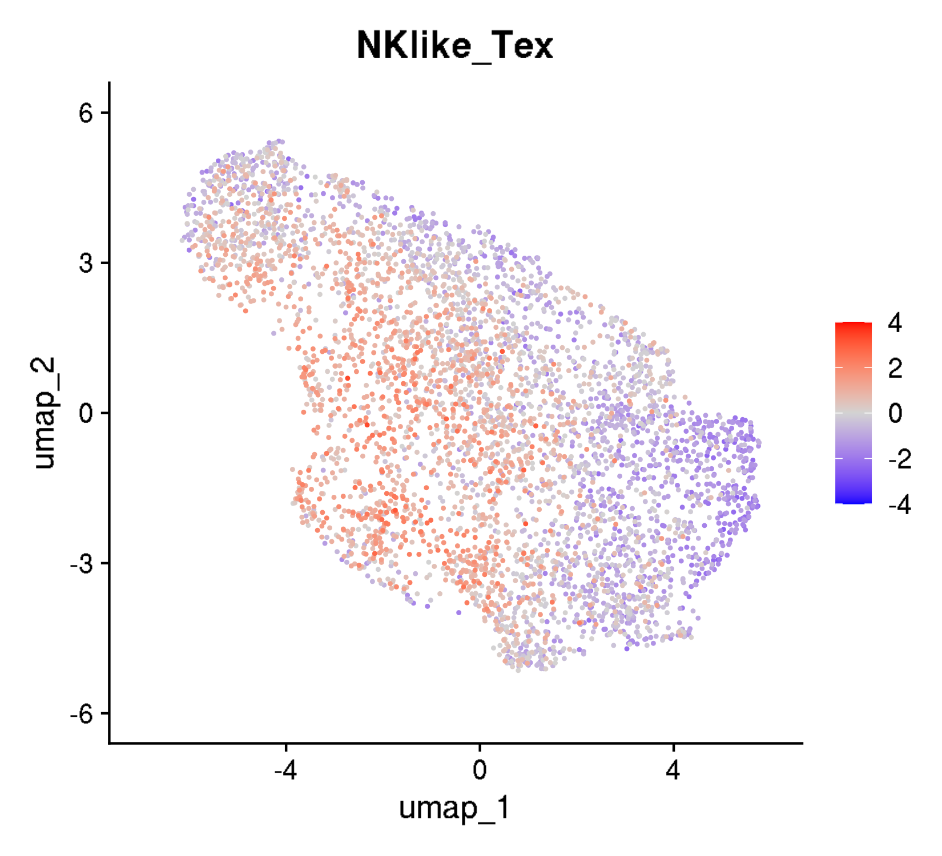
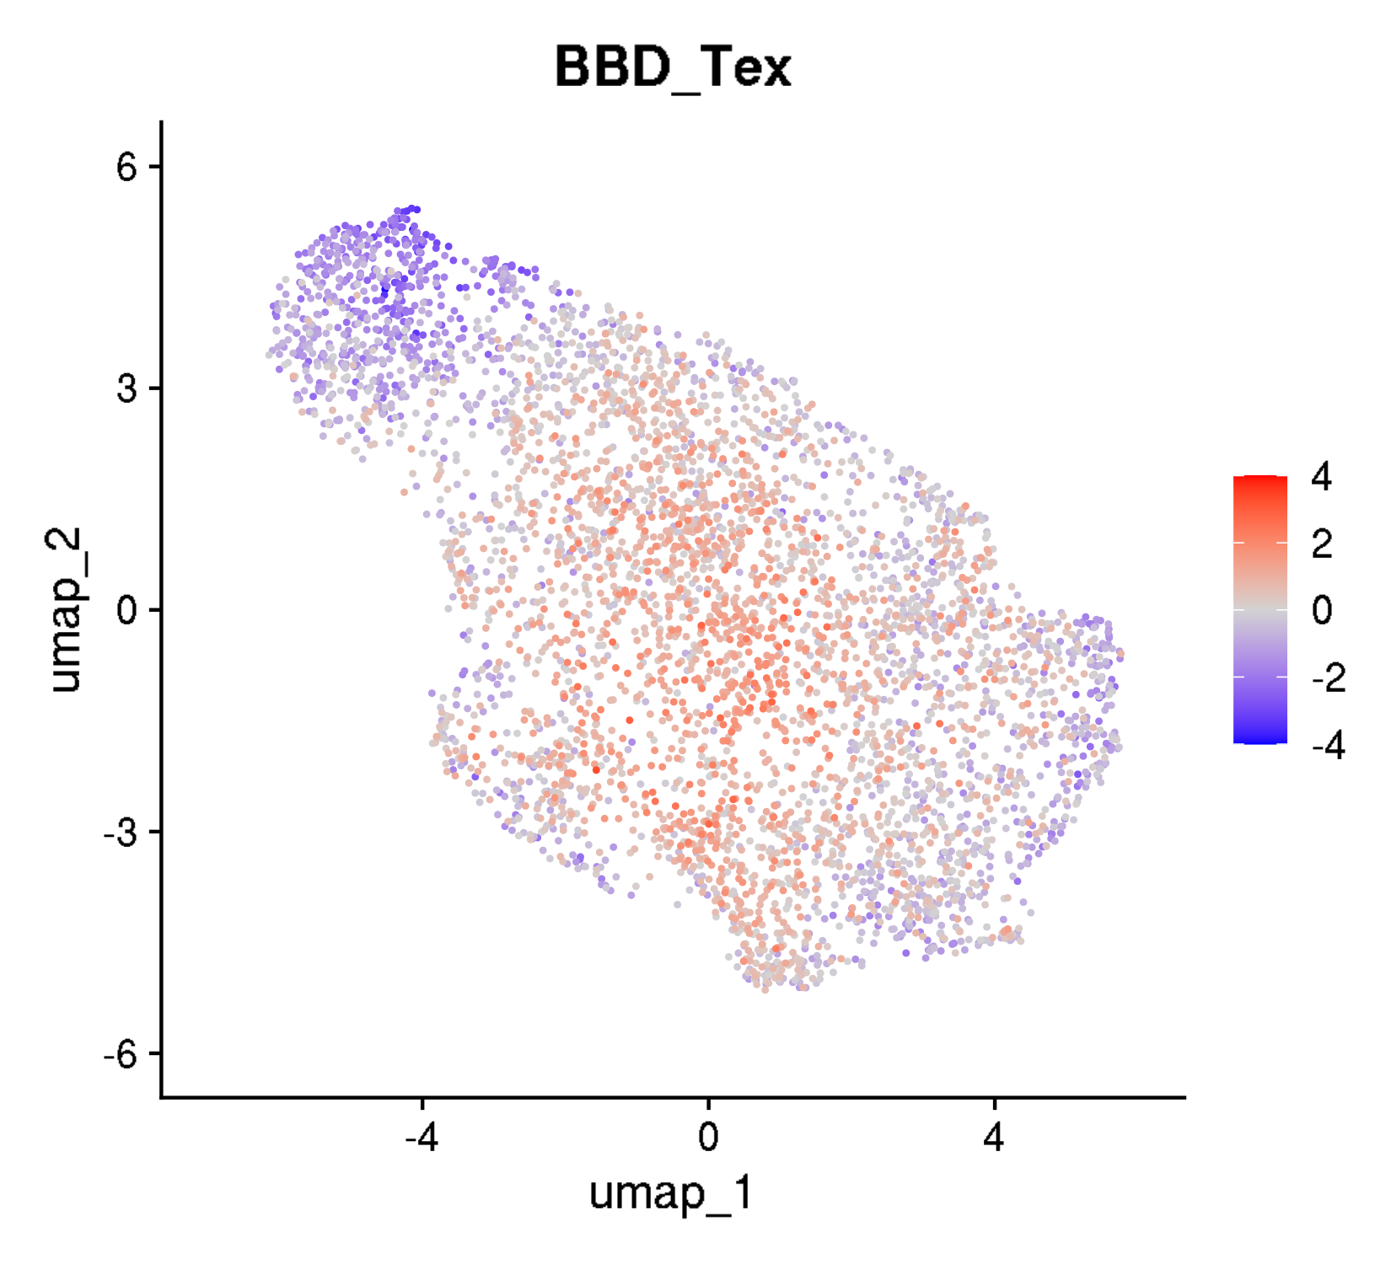
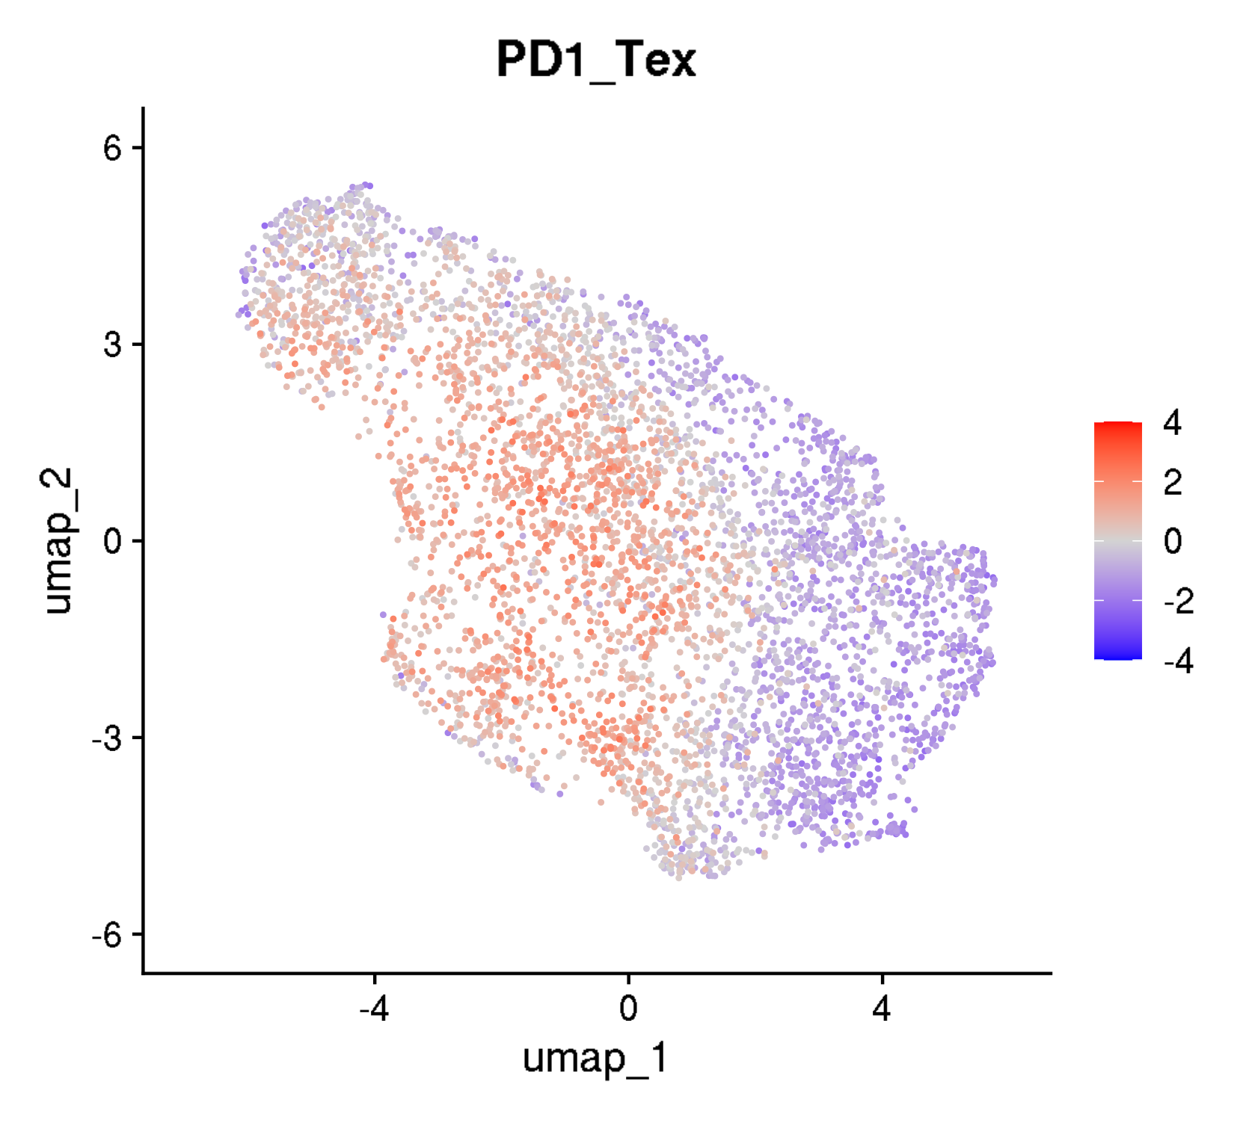
GSE120575: TILs from cancer patients receiving immune checkpoint blockade
UMAPs for exhaustion scores

Slide 6
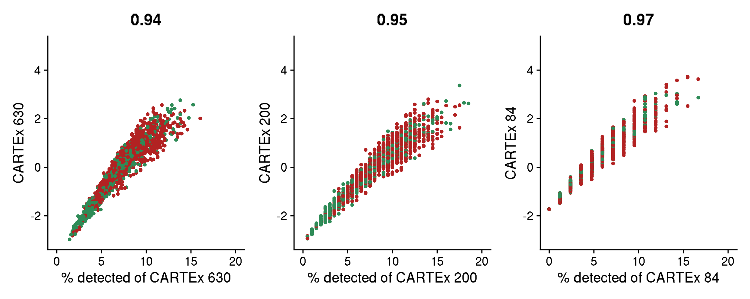
GSE120575: TILs from cancer patients receiving immune checkpoint blockade
Percentage of CARTEx detected

Slide 7
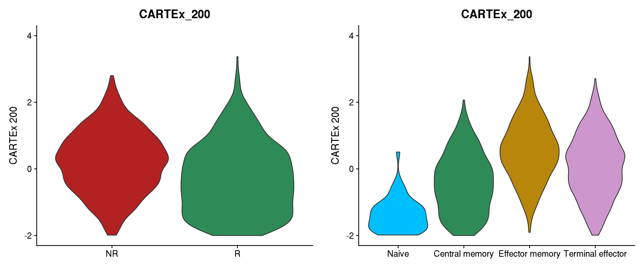
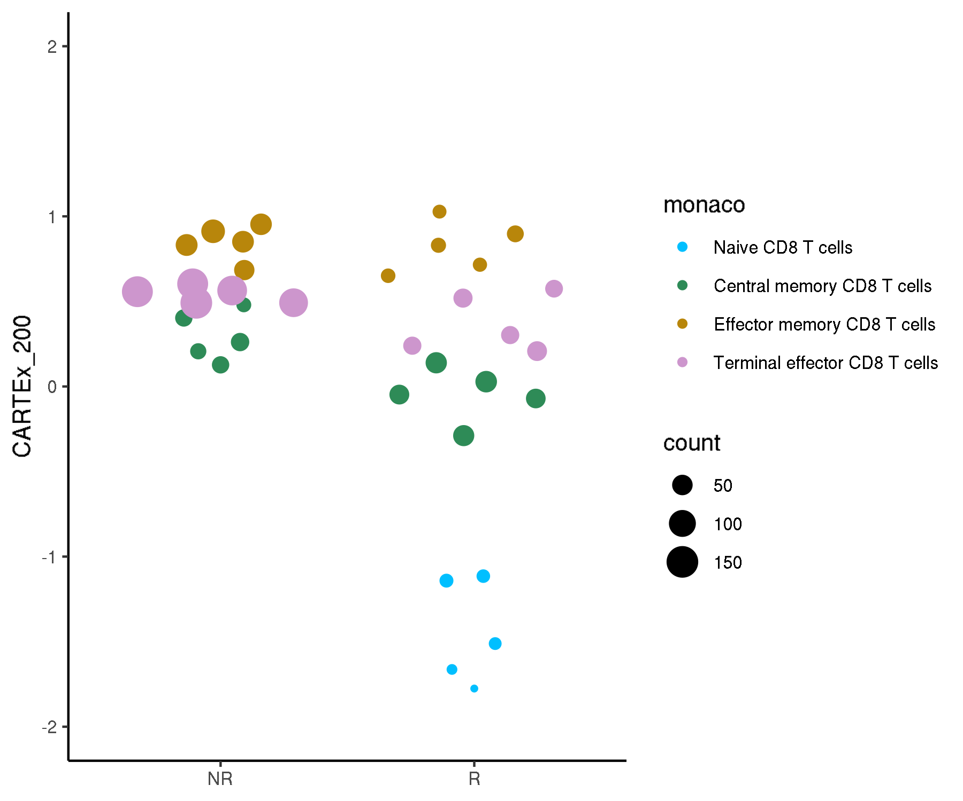
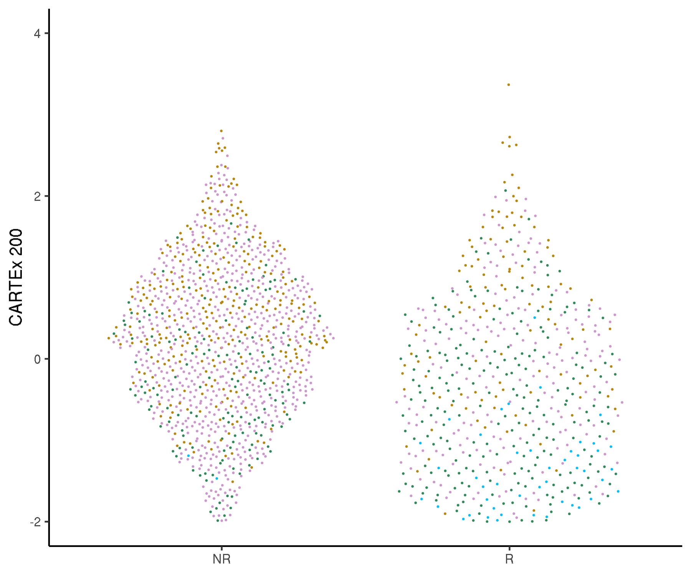
GSE120575: TILs from cancer patients receiving immune checkpoint blockade
Cell type differentiation

Slide 8
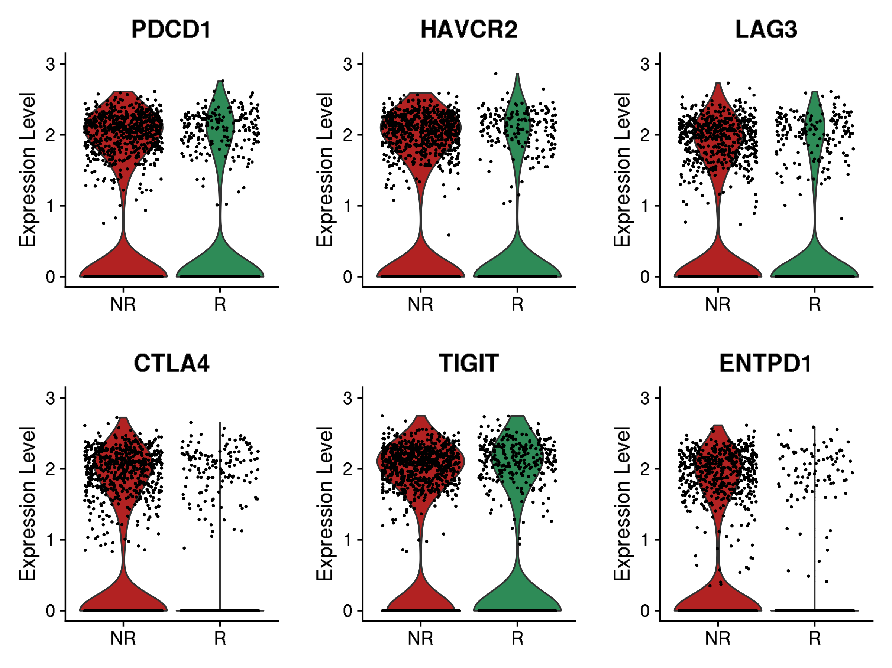
GSE120575: TILs from cancer patients receiving immune checkpoint blockade
Violin plots for canonical exhaustion markers (baseline)
Gene and corresponding protein
PDCD1 encodes PD-1
HAVCR2 encodes TIM-3
LAG3 encodes LAG-3
CTLA4 encodes CTLA-4
TIGIT encodes TIGIT
ENTPD1 encodes CD39

Slide 9
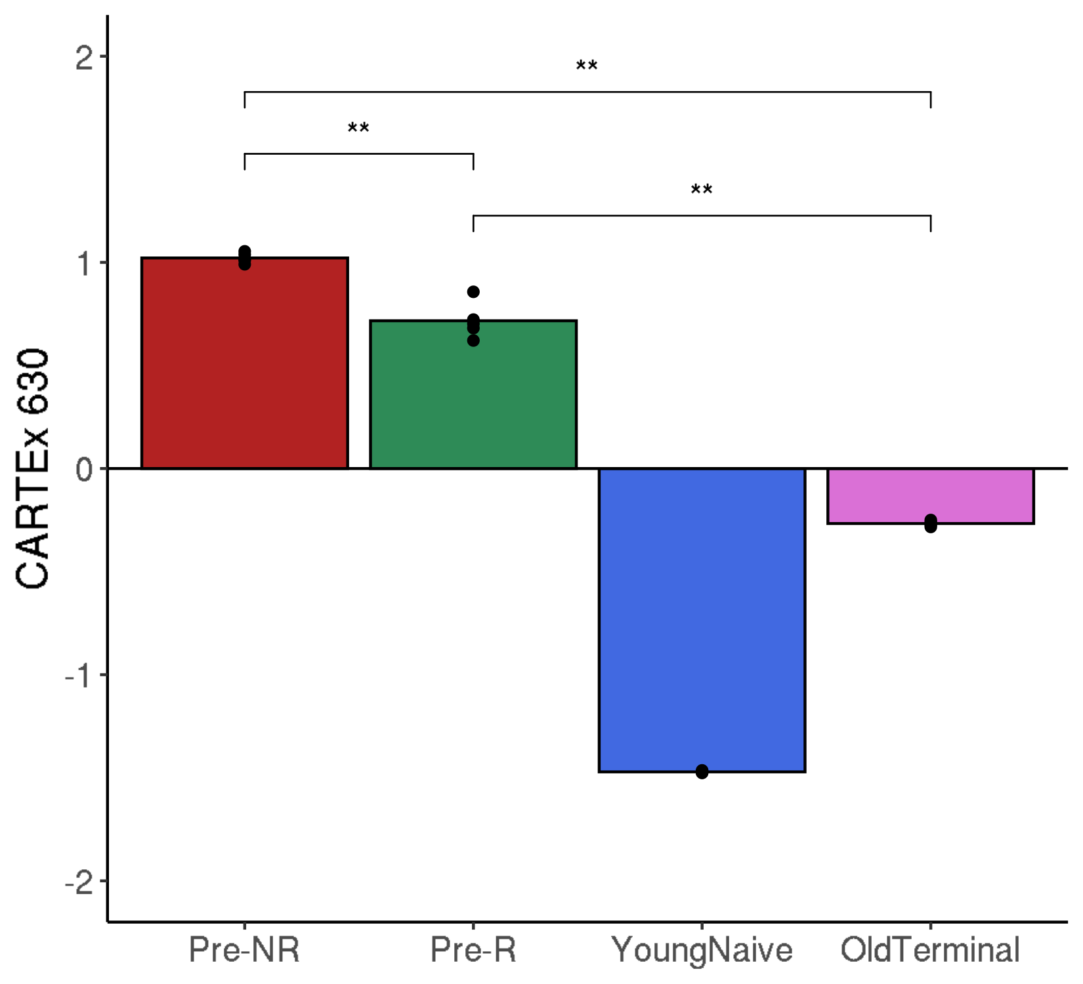
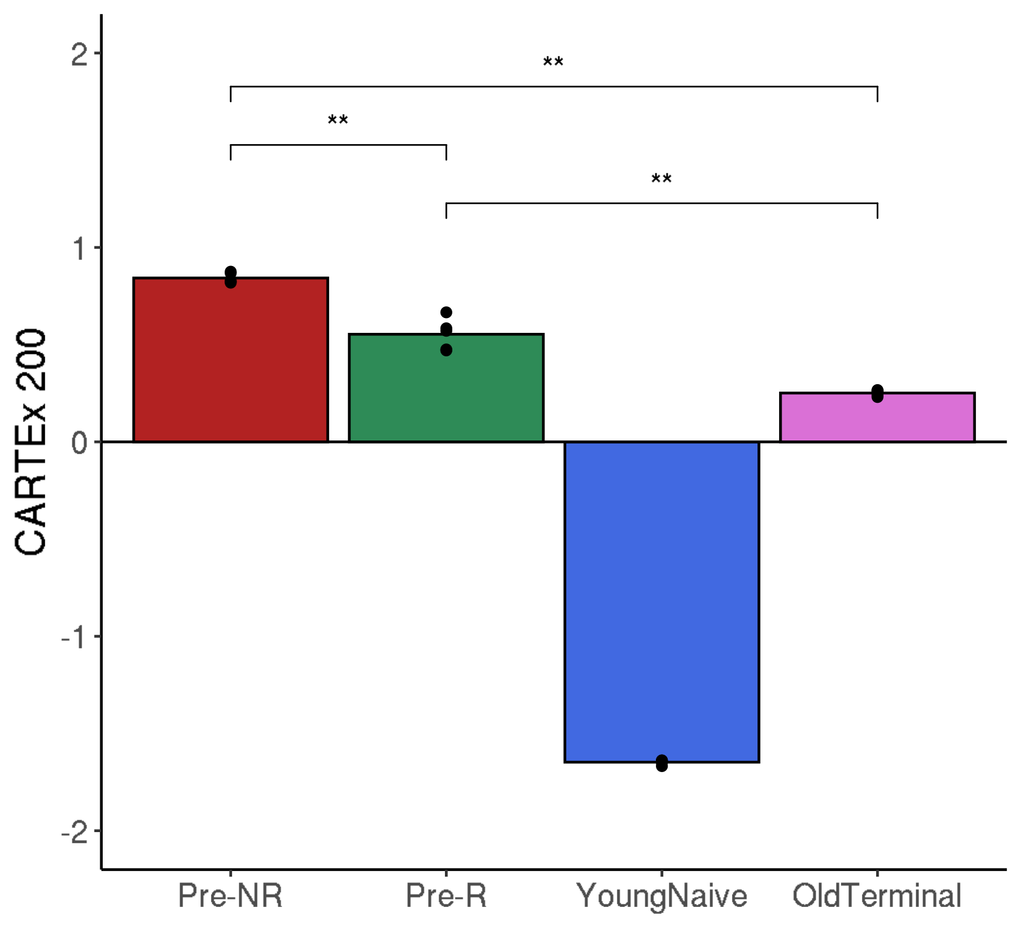
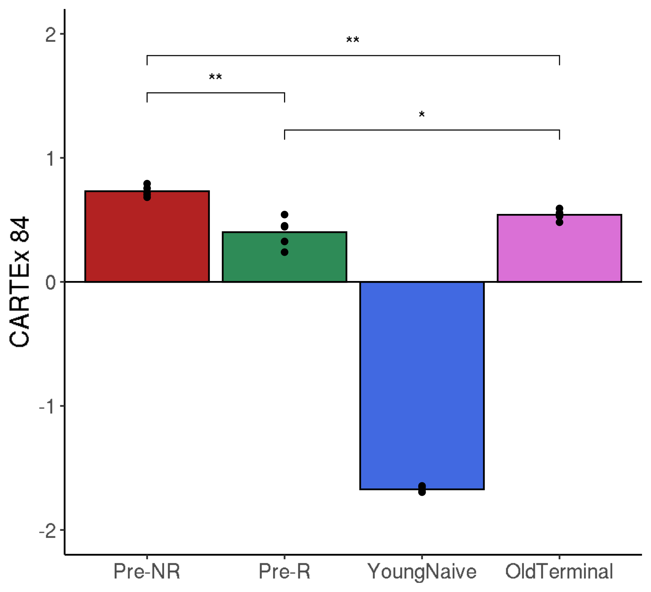
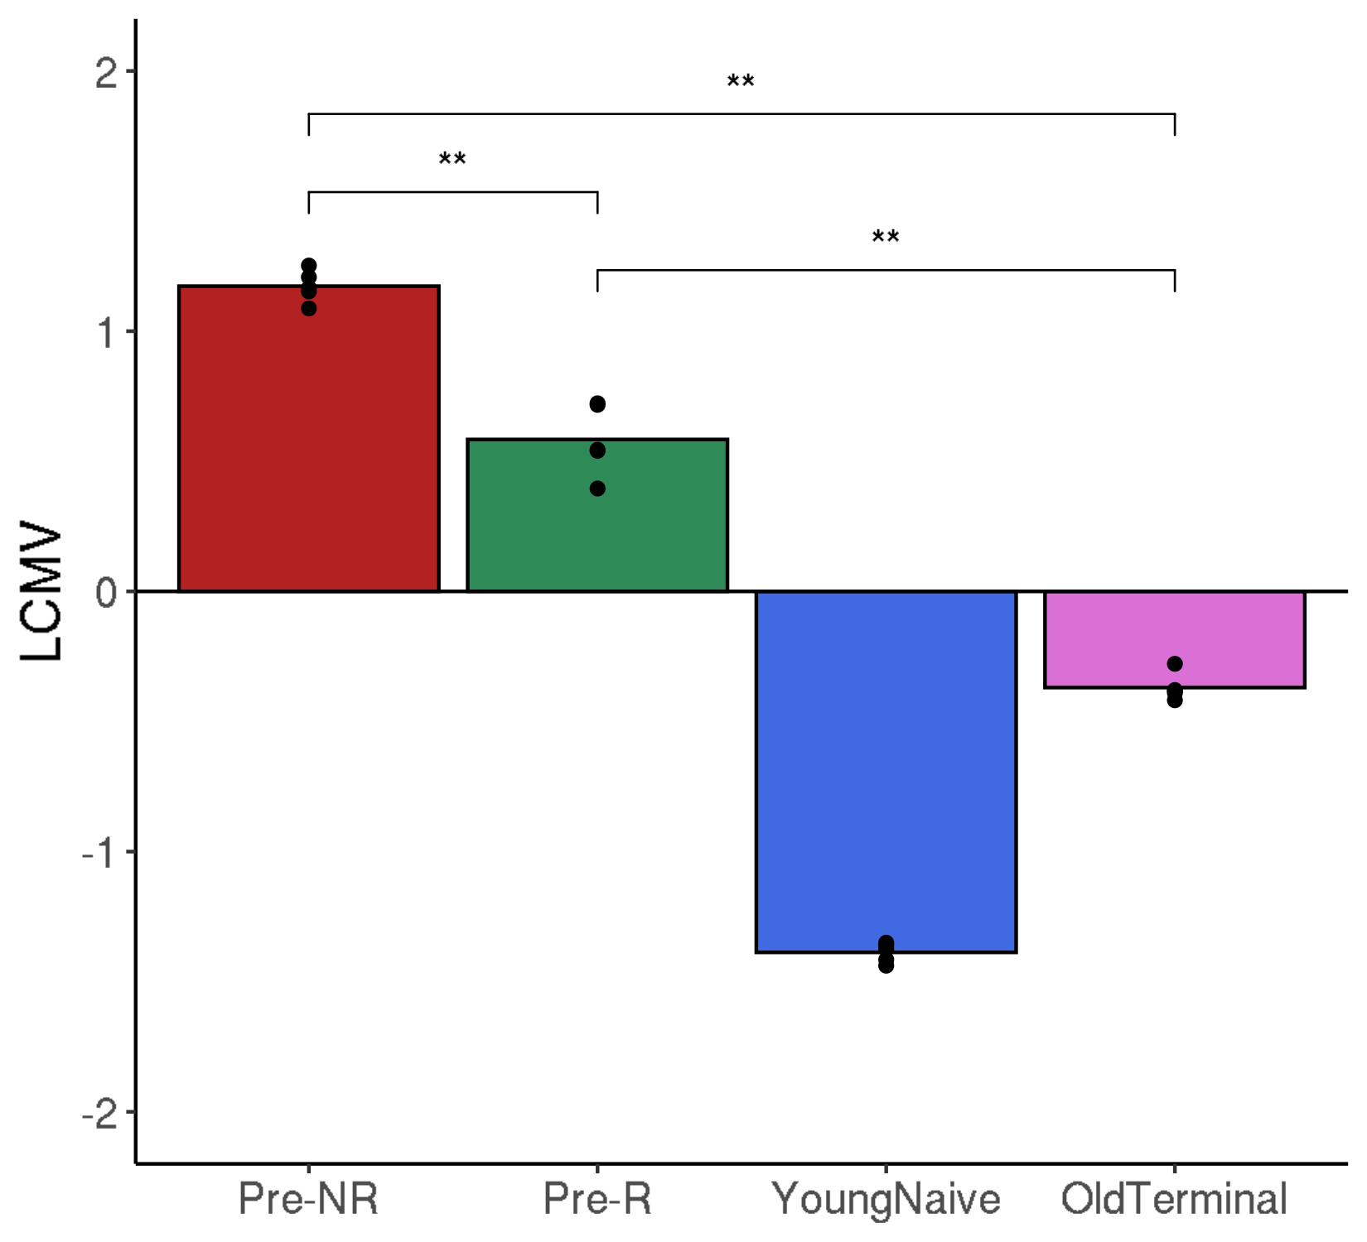
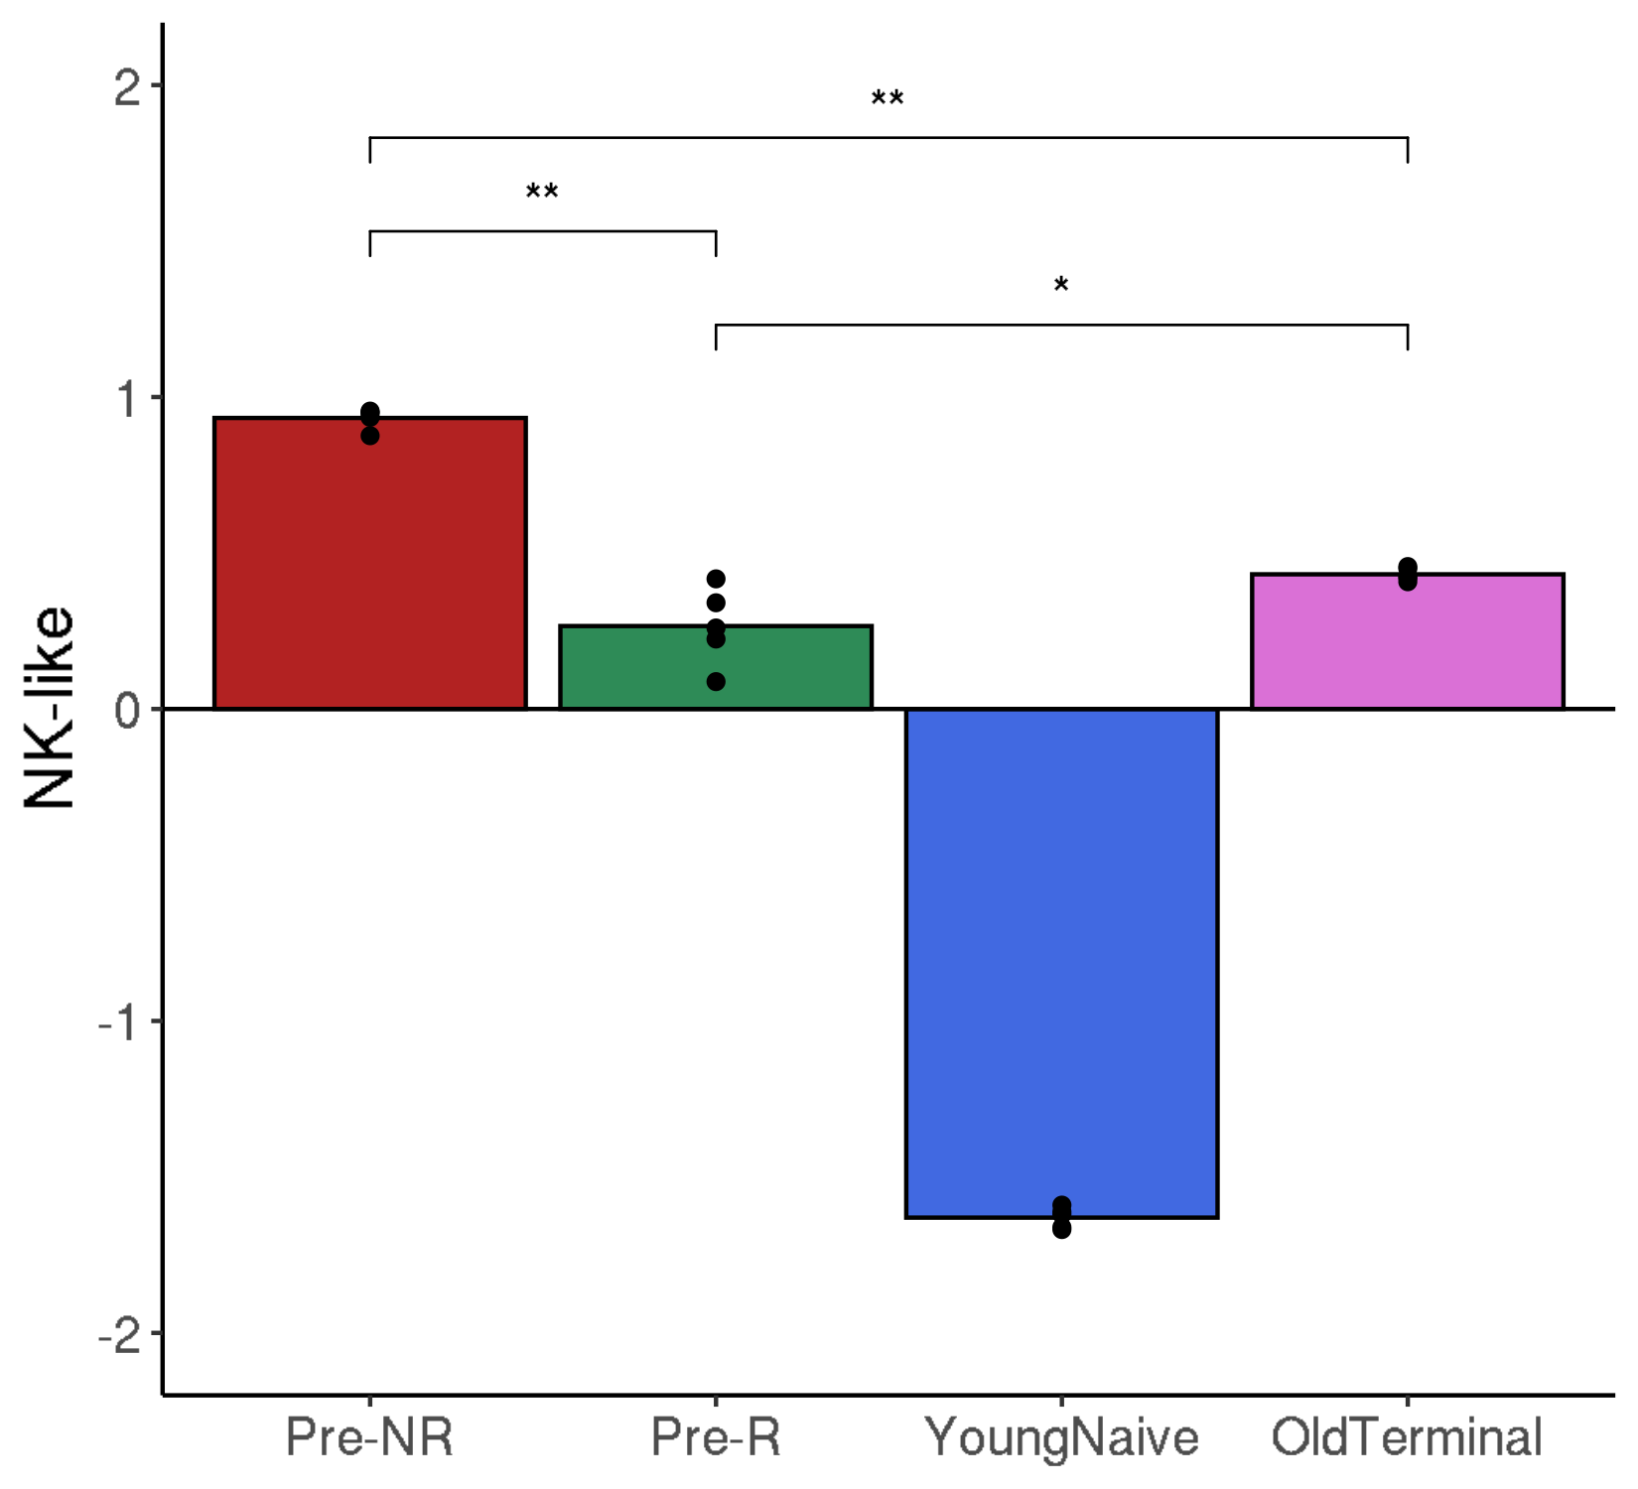
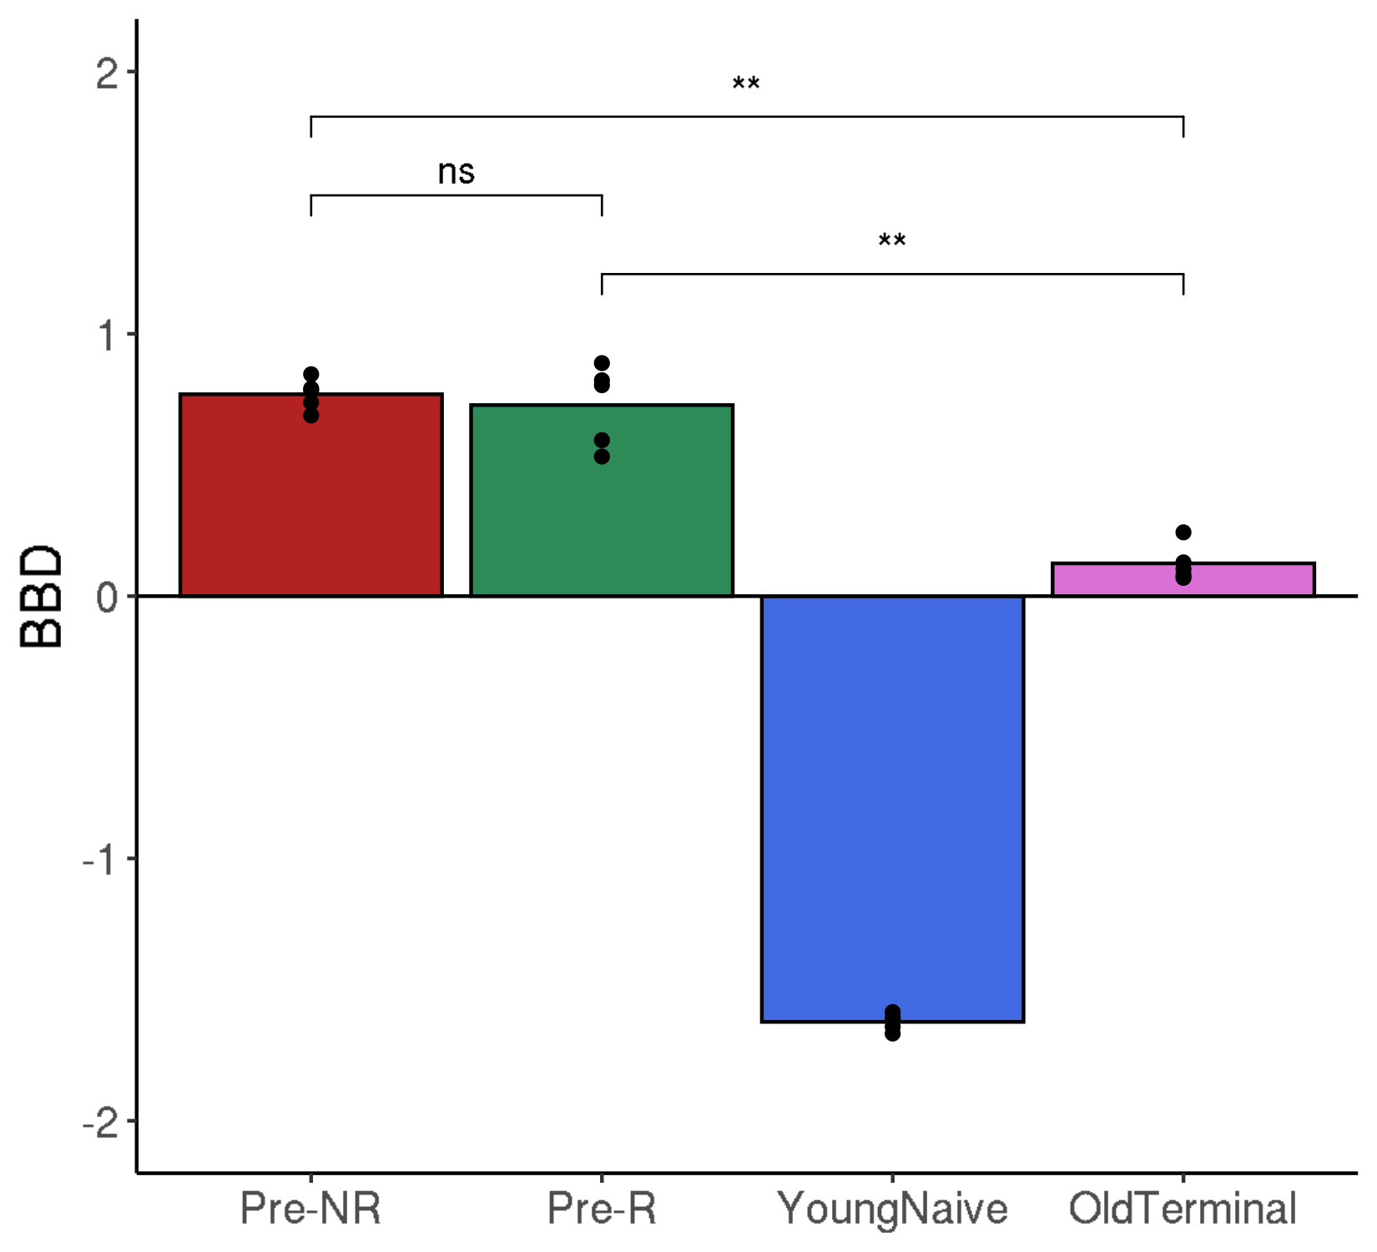
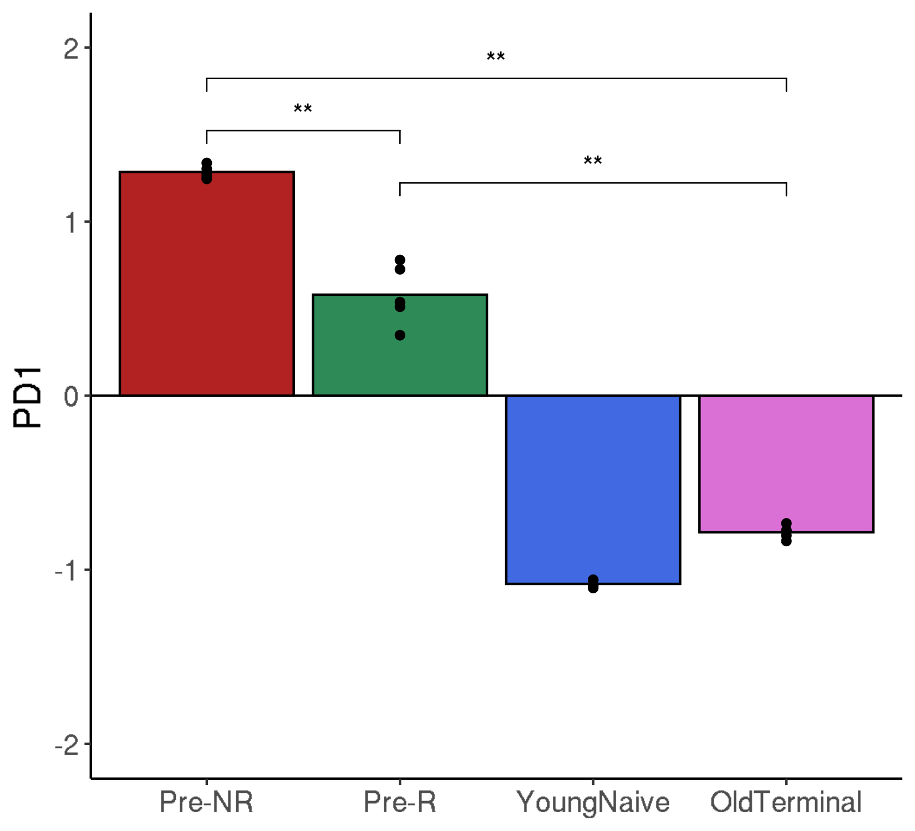
GSE120575: TILs from cancer patients receiving immune checkpoint blockade
Pseudo-bulk exhaustion scores (baseline)

Slide 10
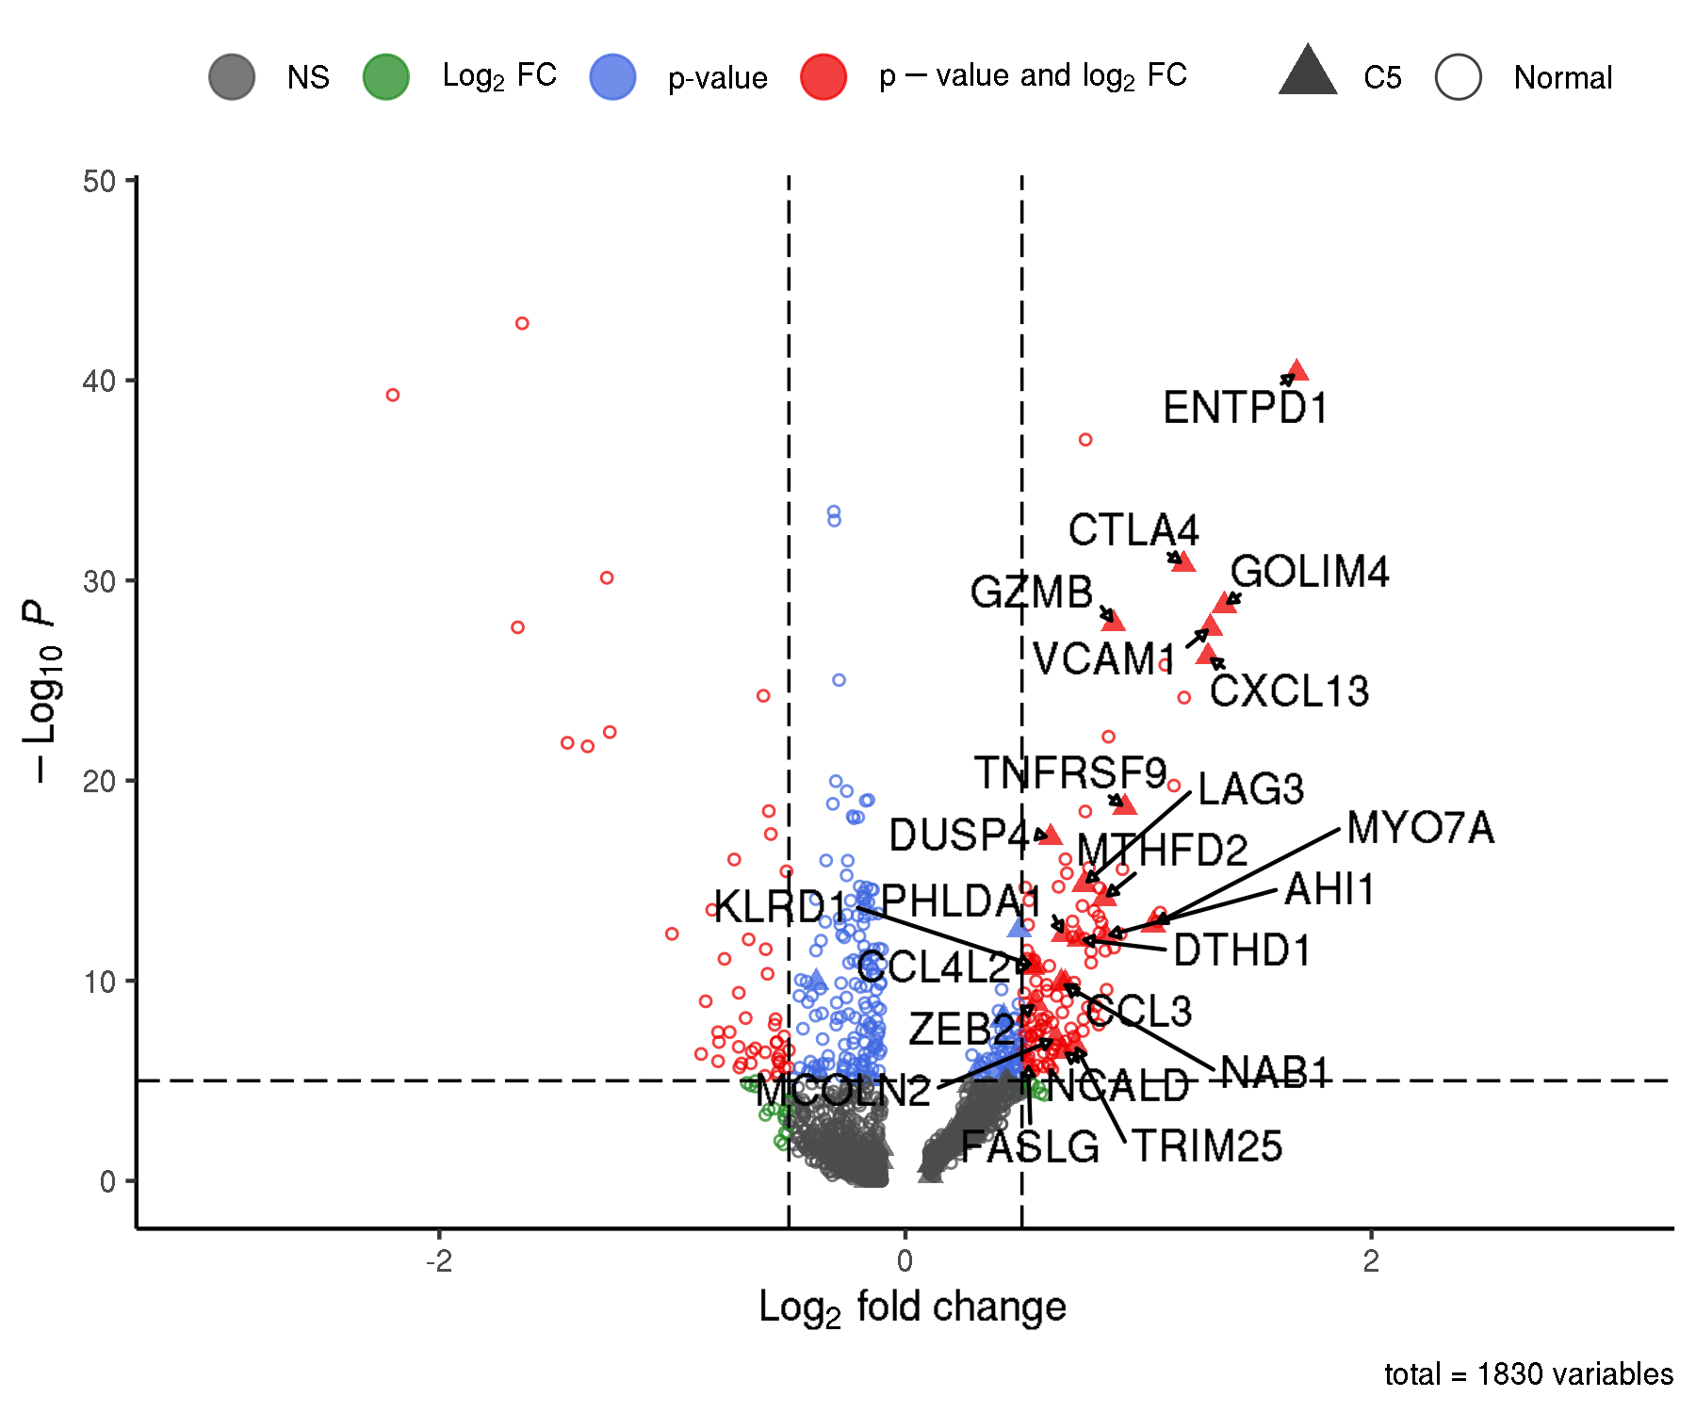
GSE120575: TILs from cancer patients receiving immune checkpoint blockade
Differentially expressed genes

